Slide 1

Introduction to Channel Coding

Slide 2
Communication System
Message Signal
Transmitter
Channel
Receiver
Estimate of message signal
在無線通訊中message不利於傳輸所以會需要去做調變讓它利於傳輸，那調變的話就是用震盪器產生載波(高頻弦波)去載message訊號，而接收端的部分則需看傳輸端怎麼改變的接收端也要照改變方式，去把傳輸端傳過來的訊號去還原回來。

Slide 3
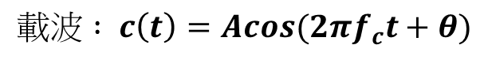
Analog Communication System
Analog Modulation
Amplitude Modulation(AM)
Angle Modulation
Frequency Modulation(FM)
Phase Modulation(PM)
$$載波 : c\left(t\right)=Acos(2πf_{c}t+θ)$$
Amplitude
Frequency
Phase
根據把訊號放在不同的位置代表不同的調變，假設把訊號放在Amplitude則代表AM，放在頻率則代表FM。
Estimate of
message signal
Message Signal
Modulator
Channel
Demodulator

Slide 4
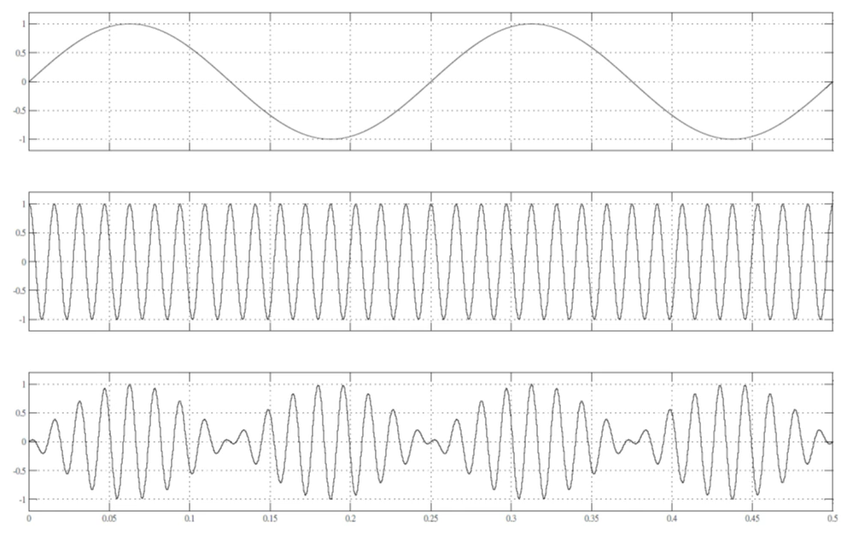
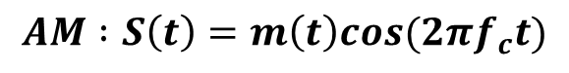
Amplitude Modulation(AM)
$$AM :S\left(t\right)=m\left(t\right)cos(2πf_{c}t)$$
Example:
If message signal is 4Hz
If carrier signal is 64Hz
We can get the modulation signal

Slide 5
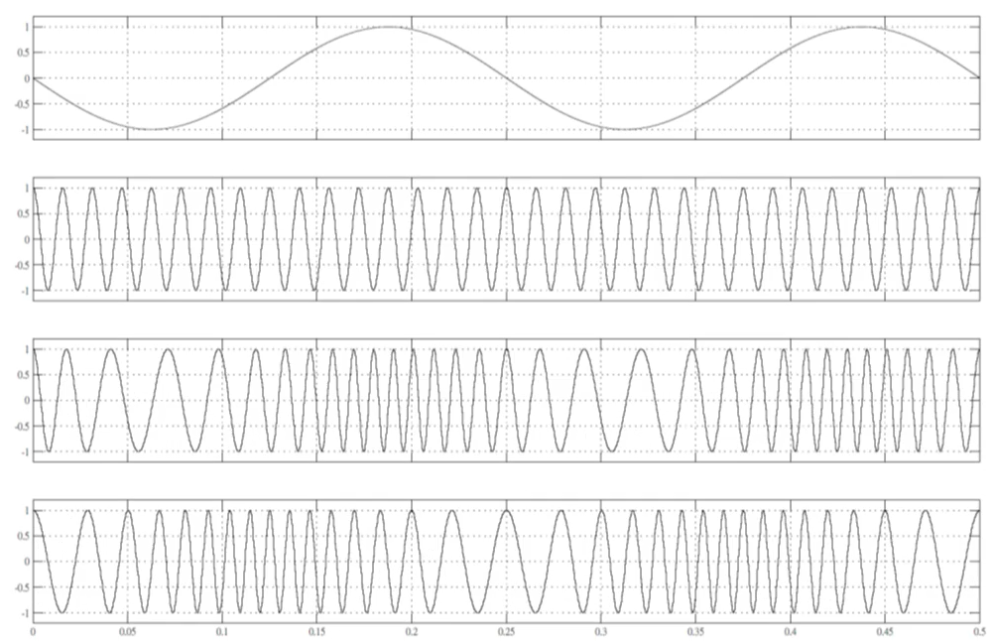
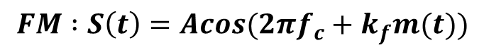
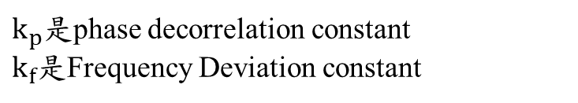
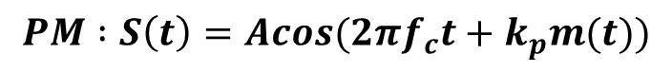
Angle Modulation
$$PM :S\left(t\right)=Acos(2πf_{c}t+k_{p}m(t))$$
$k_{p}$是phase decorrelation constant
$k_{f}$是Frequency Deviation constant
$$FM :S\left(t\right)=Acos(2πf_{c}+k_{f}m(t))$$
Example:
If message signal is 4Hz
If carrier signal is 64Hz
We can get the FM signal
FM
We can get the PM signal
PM

Slide 6
Angle Modulation
$$PM :S\left(t\right)=Acos(2πf_{c}t+k_{p}m(t))$$
$k_{p}$是phase decorrelation constant
$k_{f}$是Frequency Deviation constant
$$FM :S\left(t\right)=Acos(2πf_{c}+k_{f}m(t))$$
Example:
紅色部分可以看到如果訊號越強則調變過後的FM訊號則越密，藍色部分是0的話調變後PM訊號會跟載波一致
FM
PM

Slide 7
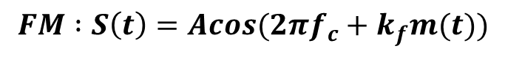
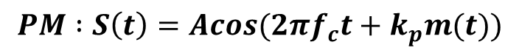
Angle Modulation
$$FM :S\left(t\right)=Acos(2πf_{c}+k_{f}m(t))$$
$k_{p}$是phase decorrelation constant
$k_{f}$是Frequency Deviation constant
$$PM :S\left(t\right)=Acos(2πf_{c}t+k_{p}m(t))$$
Example:
紅色部分可以看到如果，斜率是正的話PM訊號就會越密，負的話PM訊號頻率越小。
FM
PM

Slide 8
Digital Communication System
Digitial Modulation
Amplitude Shift Modulation (ASK)
Frequency Shift Modulation (FSK)
Phase Shift Modulation(PSK)
Quadrature Amplitude Modulation(QAM)
$$載波 : c\left(t\right)=Acos(2πf_{c}t+θ)$$
Amplitude
Frequency
Phase
數位訊號的調變是在有限種狀態下去做調變的，所以數位調變是可以做訊號的重建的。跟類比調變的無窮種可能比起來，數位調變是能夠進行重建的。
Digital
Modulator
Digital
Demodulator
Estimate of
message signal
Message Signal
Channel
If message signal is not digital must use A/D
So the message signal is bit string

Slide 9
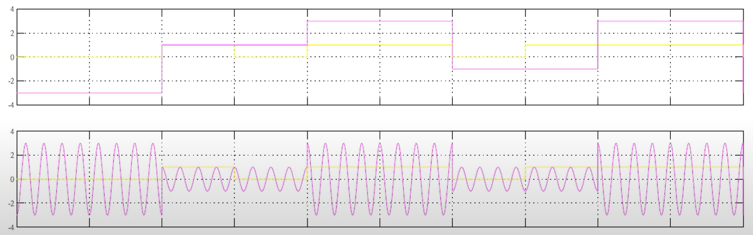
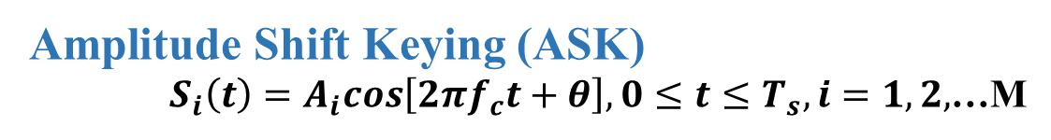
M的意思表示k個位元合起來送，那就是M會等於2^K種可能
Digital Communication System
假設每個位元時間為Tb，k個位元合起來送成為一個symbol，而一個symbol的時間是Ts，所以現在的訊號就是以一個symbol一個symbol來看，所以定義的時候都是一個symbol來看waveform。
Amplitude Shift Keying (ASK)
$S_{i}\left(t\right)=A_{i}cos\left[2πf_{c}t+θ\right],0≤t≤T_{s},i=1,2,$…M
Example:4-ASK
所以傳送的waveform就有M種可能如s(1)、s(2)、…sm(t)

Slide 10
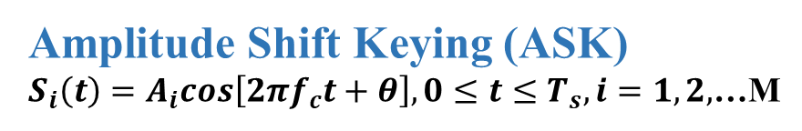
舉4-ASK也就是k=2的範例來看，這有4種可能分別為 00、01、10、11。如果用向量的表示法1D:
Digital Communication System
在ASK調變的時候通常它會用Gray code 也就是00、01、11、10的方式下去編排，因為在接收端去作解調時，會因Gray code 鄰近都只差一位元不一樣所以錯誤率會降低。
00
01
10
11
Amplitude Shift Keying (ASK)
$S_{i}\left(t\right)=A_{i}cos\left[2πf_{c}t+θ\right],0≤t≤T_{s},i=1,2,$…M
-3
-1
0
1
3
Example:4-ASK

Slide 11
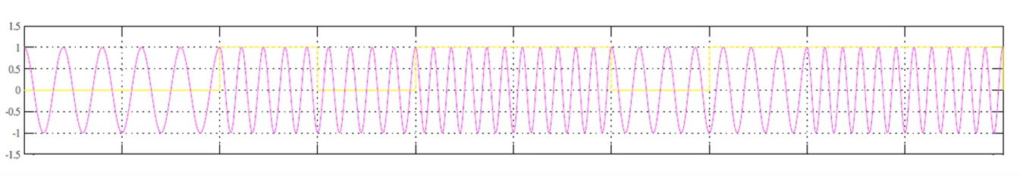
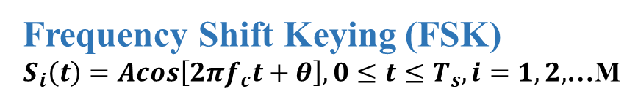
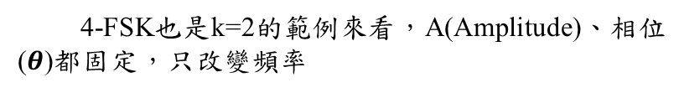
4-FSK也是k=2的範例來看，A(Amplitude)、相位($θ$)都固定，只改變頻率
Digital Communication System
Frequency Shift Keying (FSK)
$S_{i}\left(t\right)=Acos\left[2πf_{c}t+θ\right],0≤t≤T_{s},i=1,2,$…M
00
01
10
11
Example:4-FSK
5Hz
7Hz
8Hz
9Hz
11Hz
0
0
1
0
1
1
0
1
1
1
5Hz
9Hz
9Hz
7Hz
9Hz
1
2
3
4
5

Slide 12
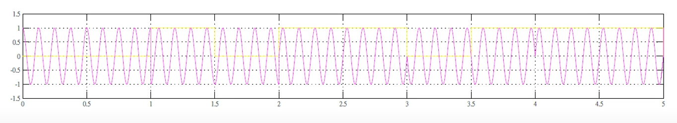
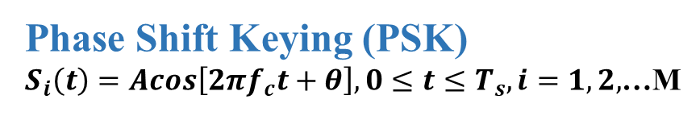
QPSK改變相位0~2$π$來看，舉M=4來看
Digital Communication System
01
Phase Shift Keying (PSK)
$S_{i}\left(t\right)=Acos\left[2πf_{c}t+θ\right],0≤t≤T_{s},i=1,2,$…M
10
00
Example:QPSK
11
0
0
1
0
1
1
0
1
1
1
1
2
3
4
5

Slide 13
Additive White Gaussian Noise (AWGN) Channel

Slide 14
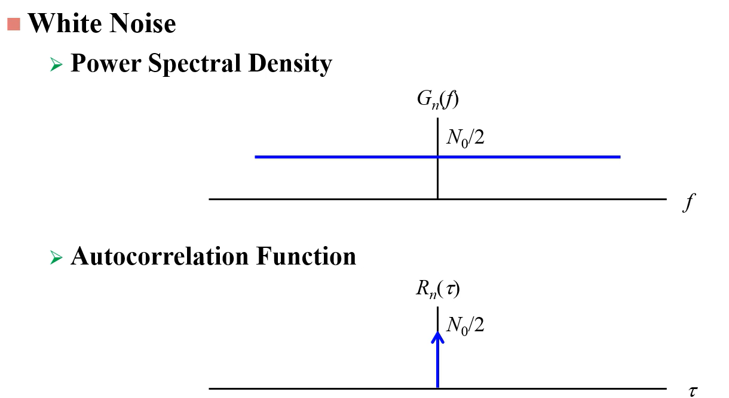

白雜訊是加在訊號之上之雜訊，而白雜訊就像光一樣在任何頻率上都會有雜訊成分在，其雜訊隻大小為$N_{0}/2$，所以去對該雜訊做傅立葉轉換會得到一個脈衝能量。

Slide 15
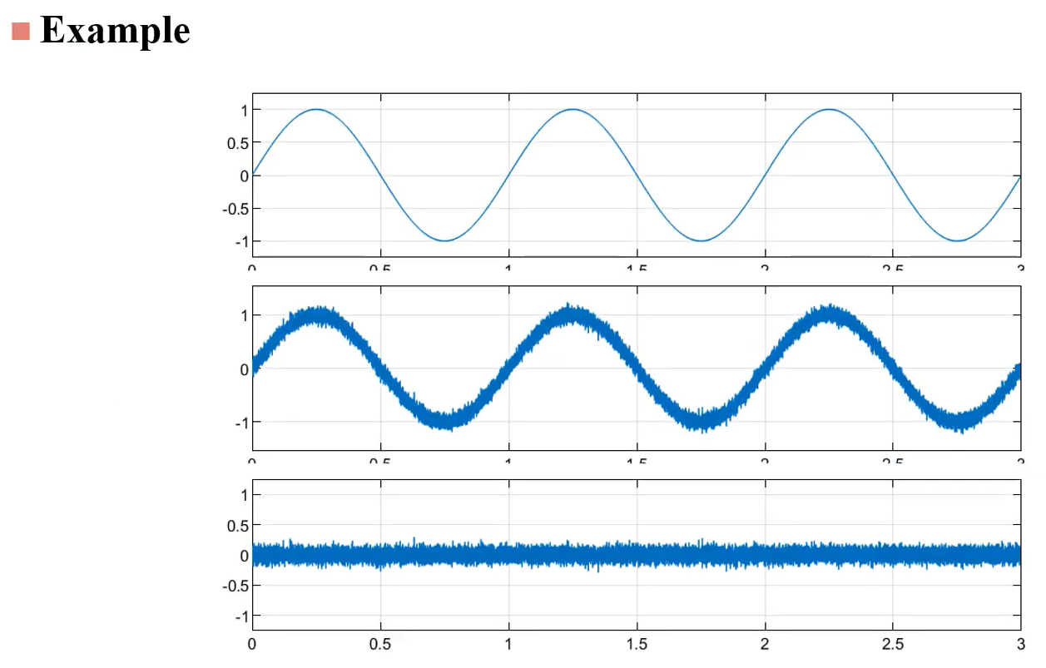
現實生活中產生sin波可以發現，sin波上會有雜訊而把sin波去掉後就只會剩下每一個時間點上隨機數值的雜訊，其雜訊為高斯分布之雜訊。

Slide 16
Why Channel Coding

Slide 17
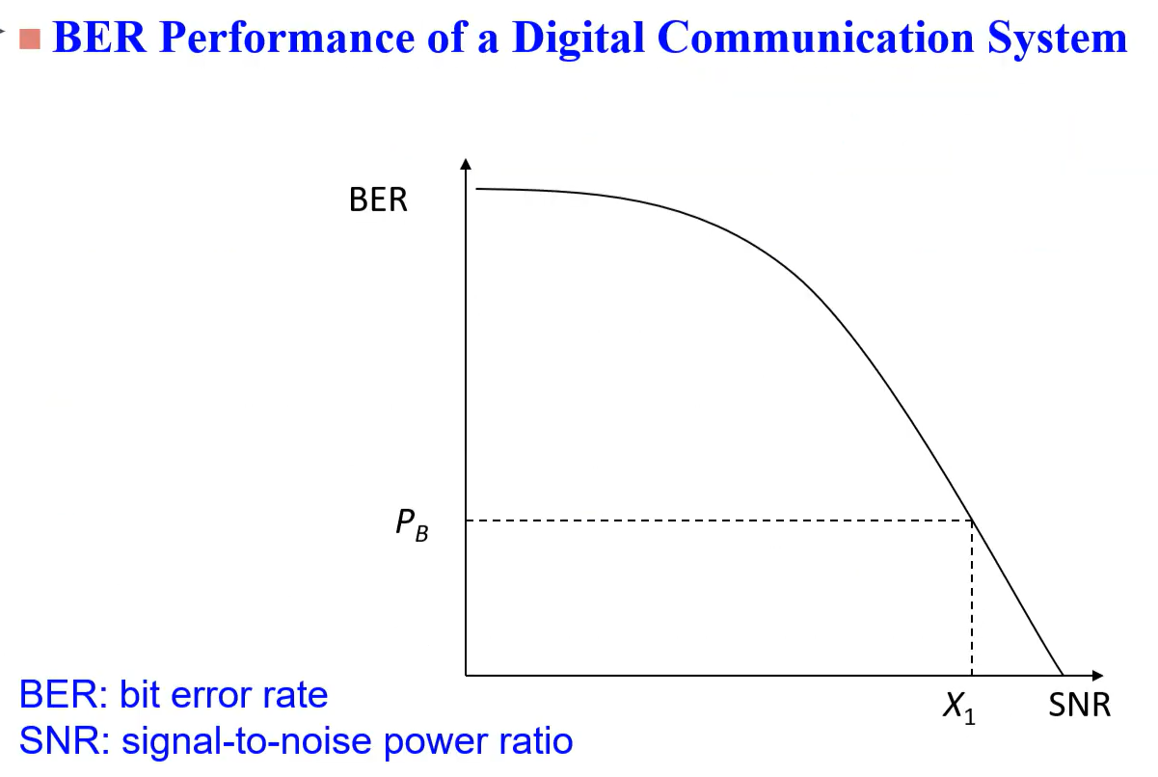
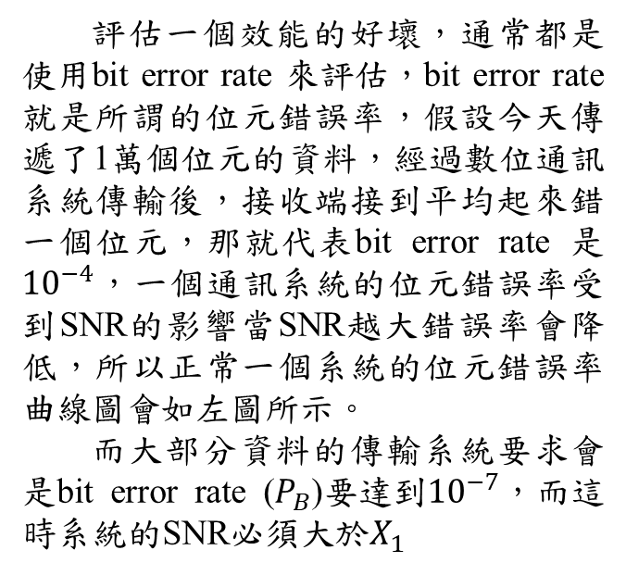
評估一個效能的好壞，通常都是使用bit error rate 來評估，bit error rate 就是所謂的位元錯誤率，假設今天傳遞了1萬個位元的資料，經過數位通訊系統傳輸後，接收端接到平均起來錯一個位元，那就代表bit error rate 是${10}^{−4}$，一個通訊系統的位元錯誤率受到SNR的影響當SNR越大錯誤率會降低，所以正常一個系統的位元錯誤率曲線圖會如左圖所示。
而大部分資料的傳輸系統要求會是bit error rate ($P_{B}$)要達到${10}^{−7}$，而這時系統的SNR必須大於$X_{1}$

Slide 18
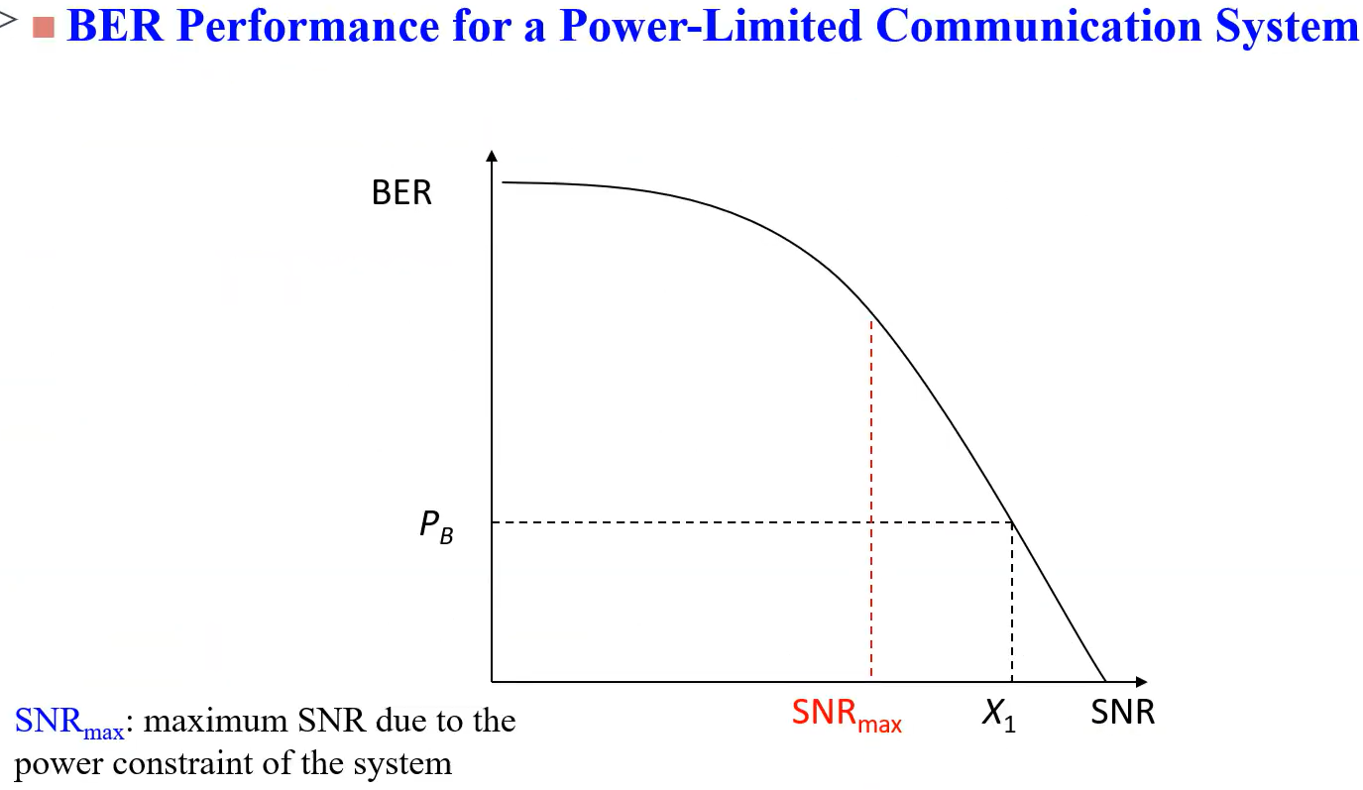
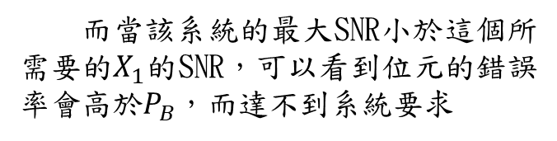
而當該系統的最大SNR小於這個所需要的$X_{1}$的SNR，可以看到位元的錯誤率會高於$P_{B}$，而達不到系統要求

Slide 19
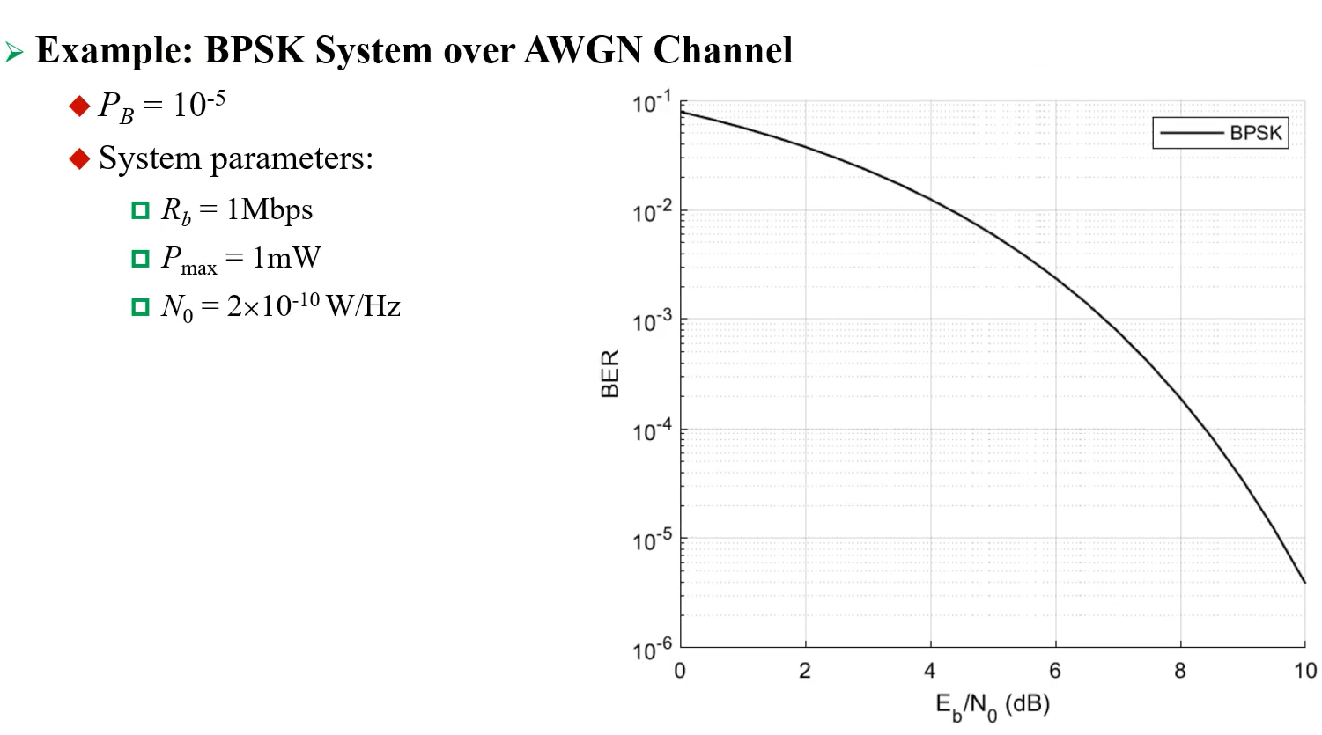
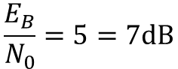
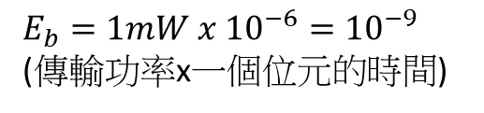
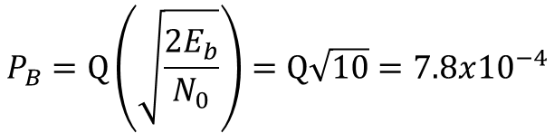
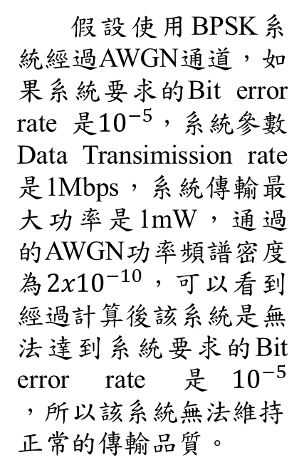
假設使用BPSK系統經過AWGN通道，如果系統要求的Bit error rate 是${10}^{−5}$，系統參數Data Transimission rate 是1Mbps，系統傳輸最大功率是1mW，通過的AWGN功率頻譜密度為${2x10}^{−10}$，可以看到經過計算後該系統是無法達到系統要求的Bit error rate 是${10}^{−5}，所以該系統無法維持$正常的傳輸品質。
$$E_{b}=1mW x {10}^{−6}={10}^{−9}$$
(傳輸功率x一個位元的時間)
$$\frac{E_{B}}{N_{0}}=5=7dB$$
$$P_{B}=Q\left(\sqrt{\frac{2E_{b}}{N_{0}}}\right)=Q\sqrt{10}=7.8x{10}^{−4}$$

Slide 20
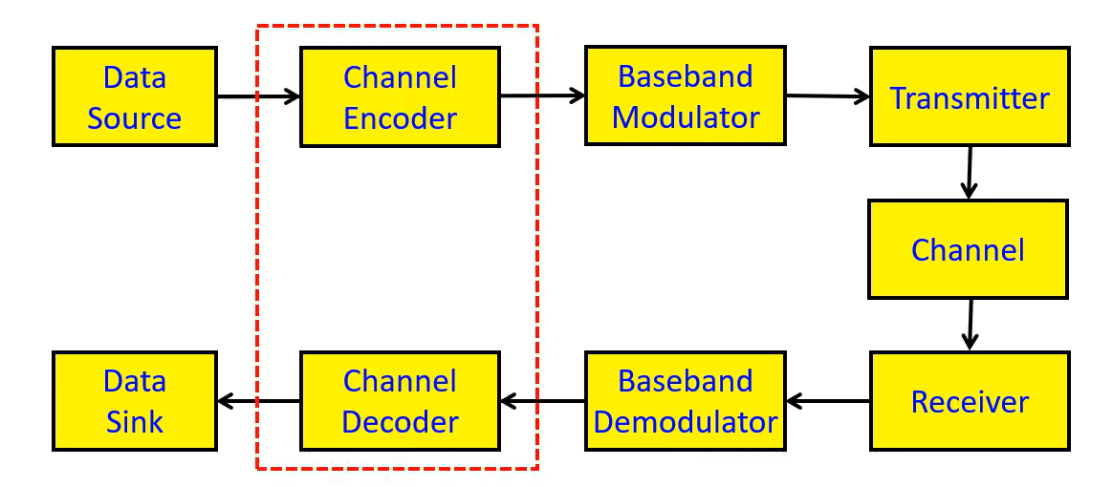
Power-Limited Communication System with Channel Coding for Improving BER Performance

Slide 21
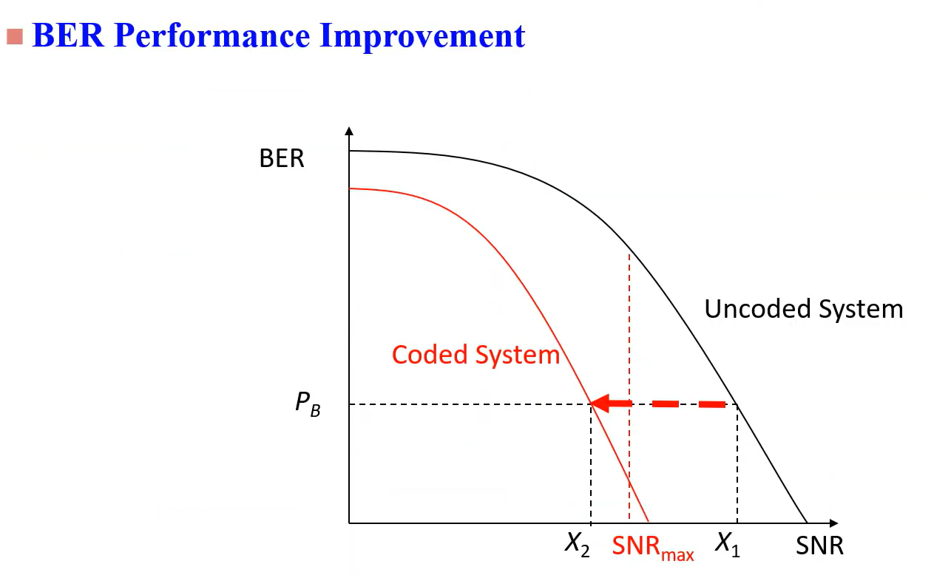

Slide 22
Example : Block Coding
假設每k個位元有一個Block，encoder的動作就是去對k進行編碼得到n個位元，而n會大於k其編碼動作就是增加資料的相關性，會增加n-k個位元就假設110編碼為001101就是1一個位元k編碼為2個位元n，以此類推將此稱作(n,k)的block code，而不同的n、k值會決定錯誤更正能力，所以通常會多加一個t去表示錯誤更正能力如(n,k,t)表示這個block可以有多少的更正能力，假設(2,1,3)就是1bit 經過encoder 會得到2bit的資料，而錯誤率則是decoder > 3個錯誤則無法有效還原資料。
k
n

Slide 23
Viterbi Decoding

Slide 24
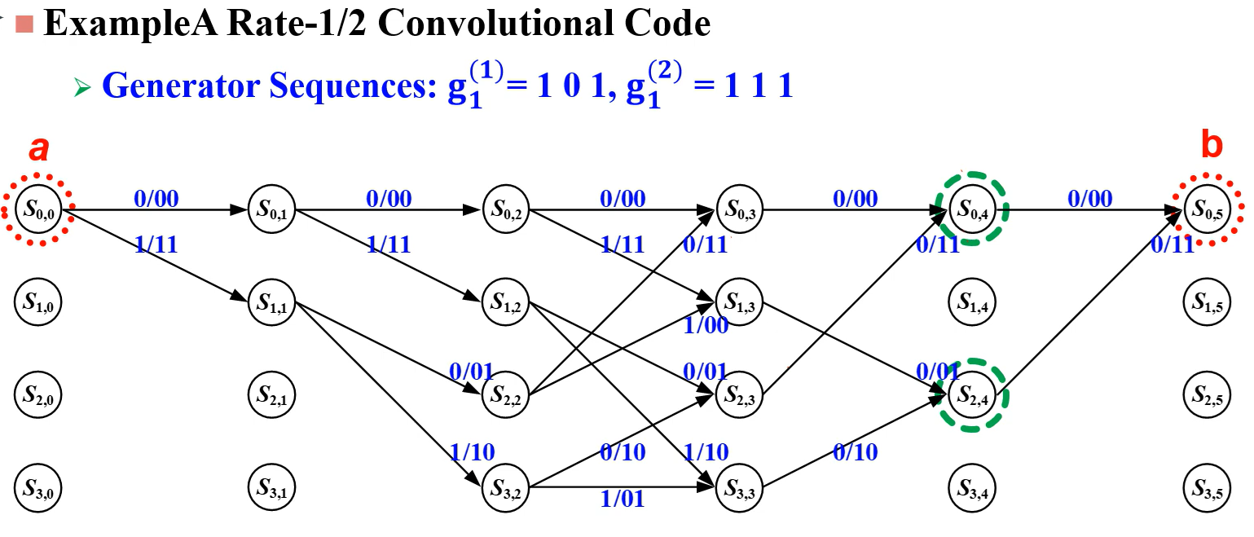

Slide 25
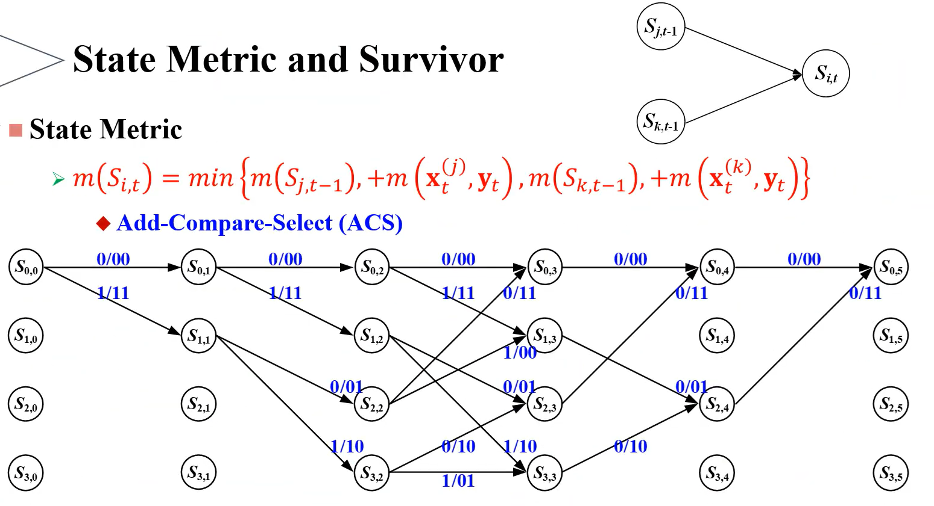

Slide 26
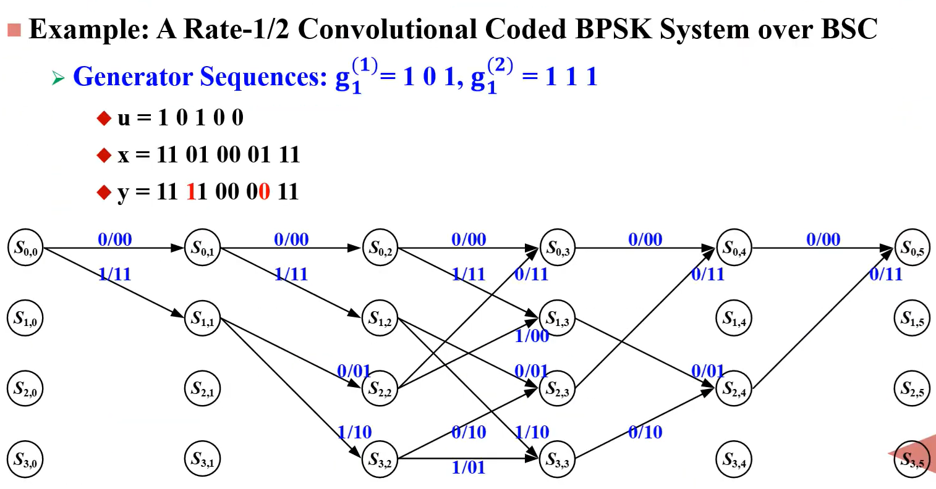

Slide 27
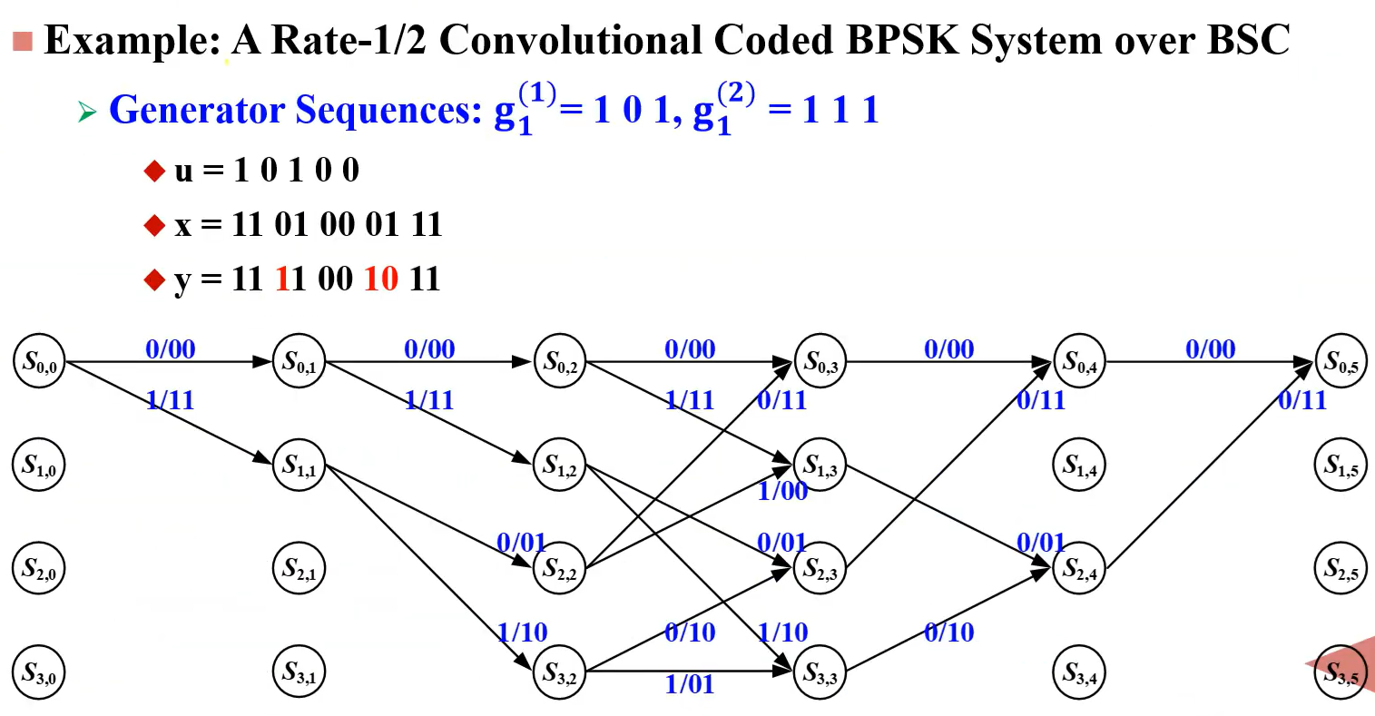

Slide 28
Survivor Decoding : Register-Exchange Decoding

Slide 29
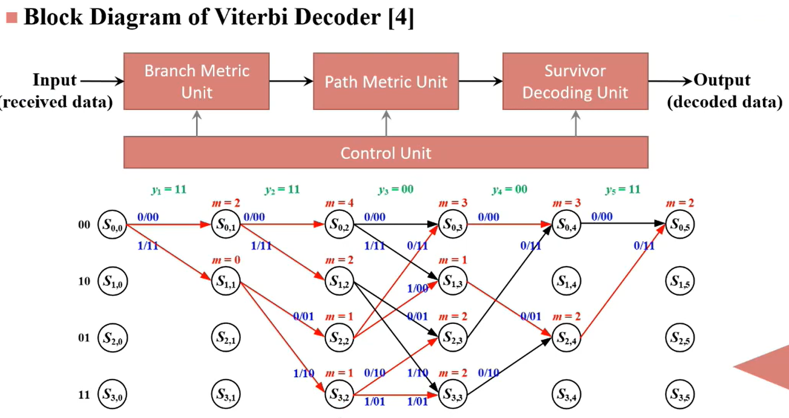

Slide 30
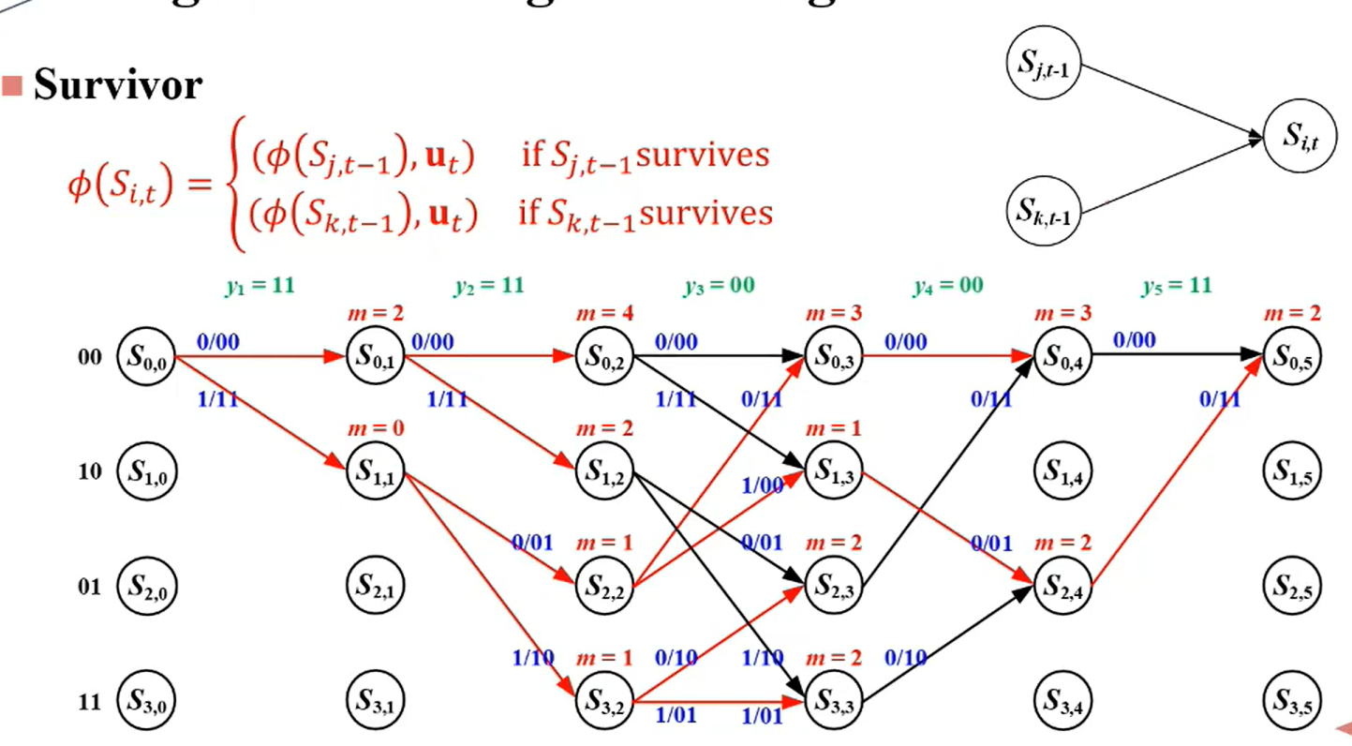

Slide 31
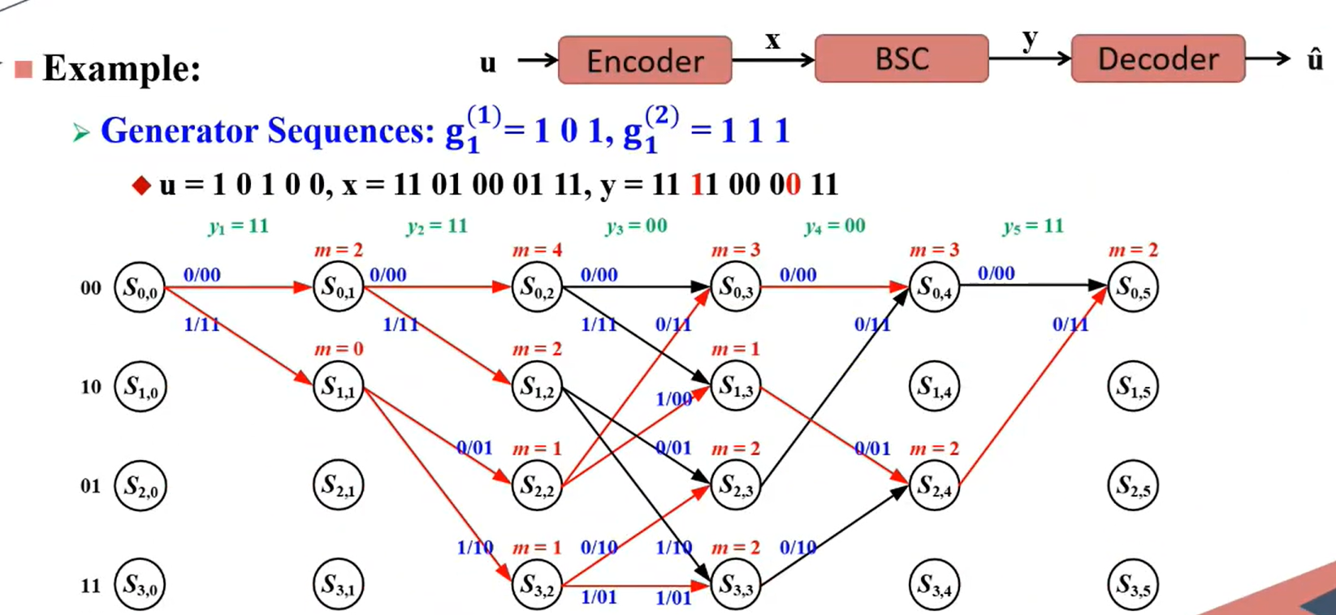

Slide 32
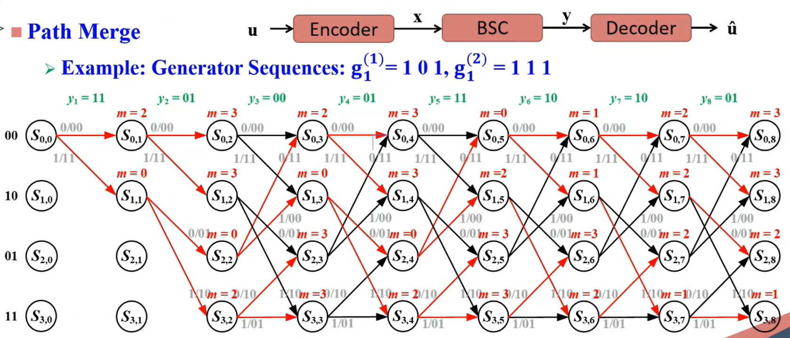

Slide 33
Survivor Decoding : Traceback Decoding

Slide 34
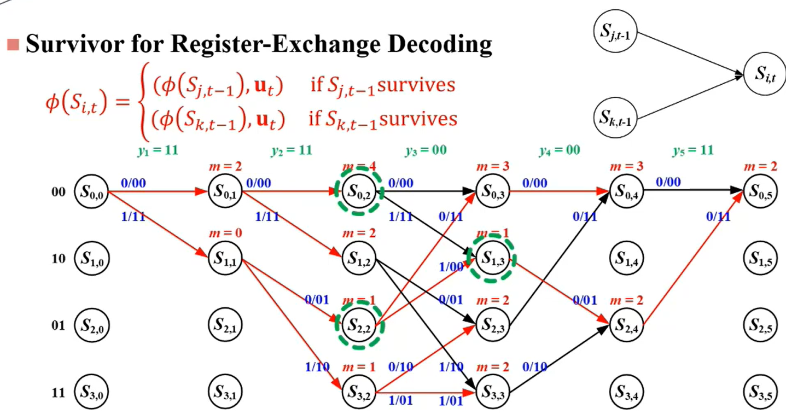

Slide 35
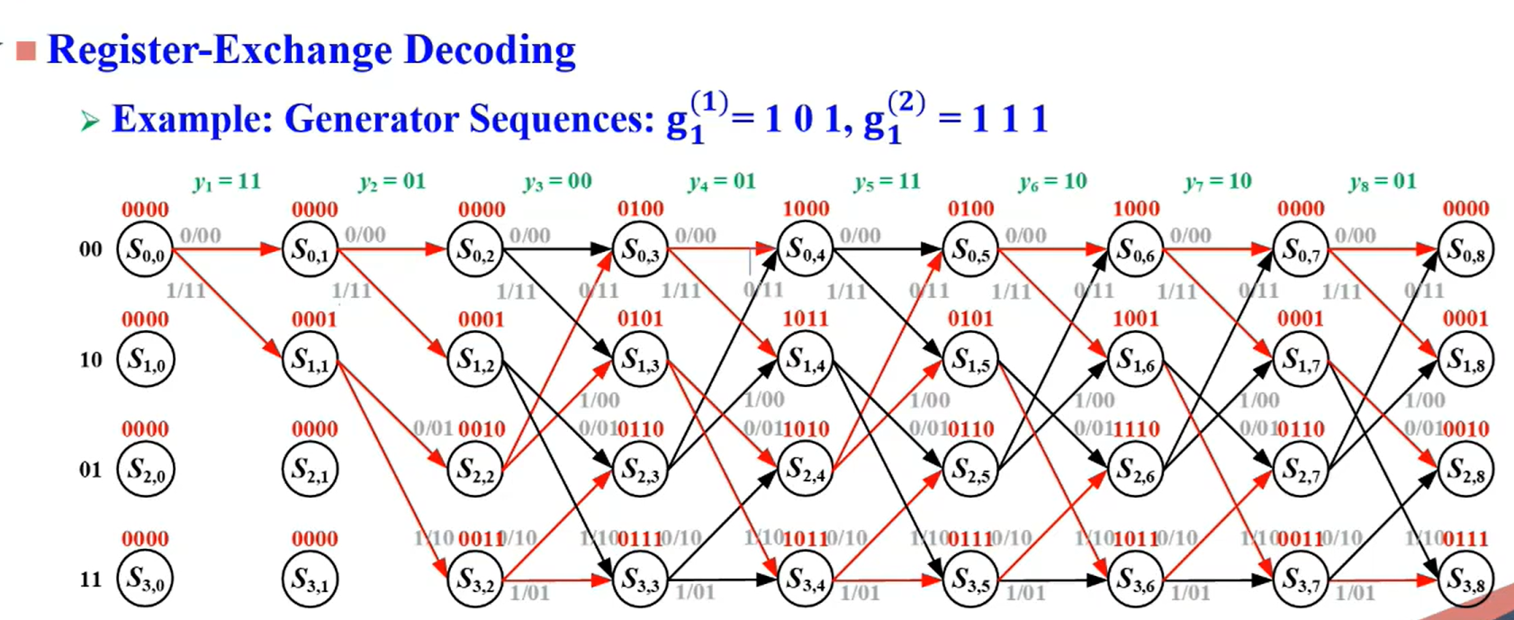

Slide 36
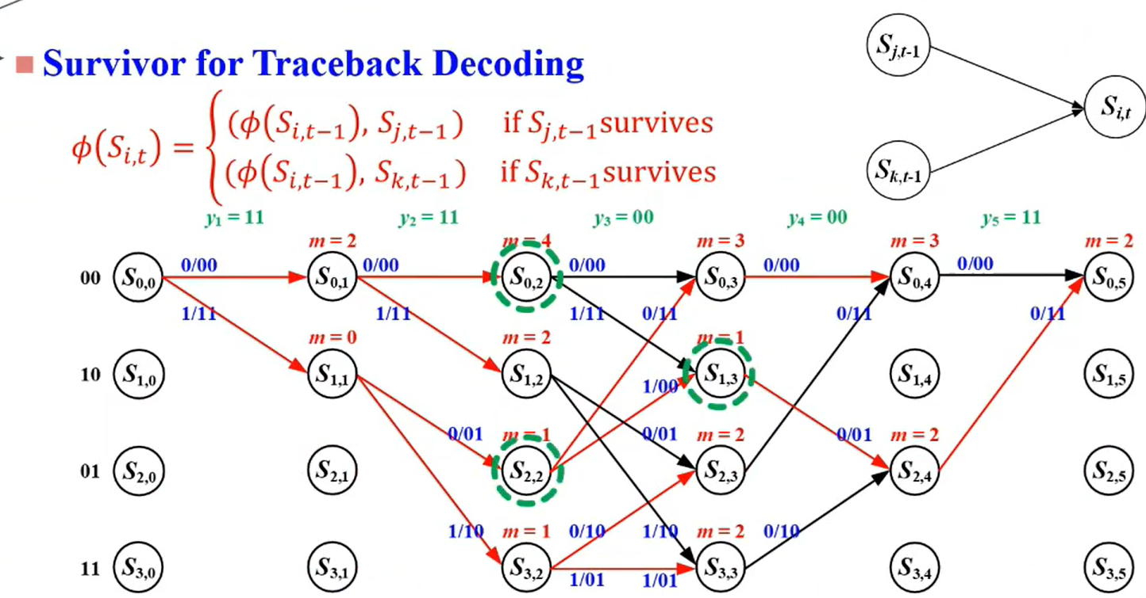

Slide 37
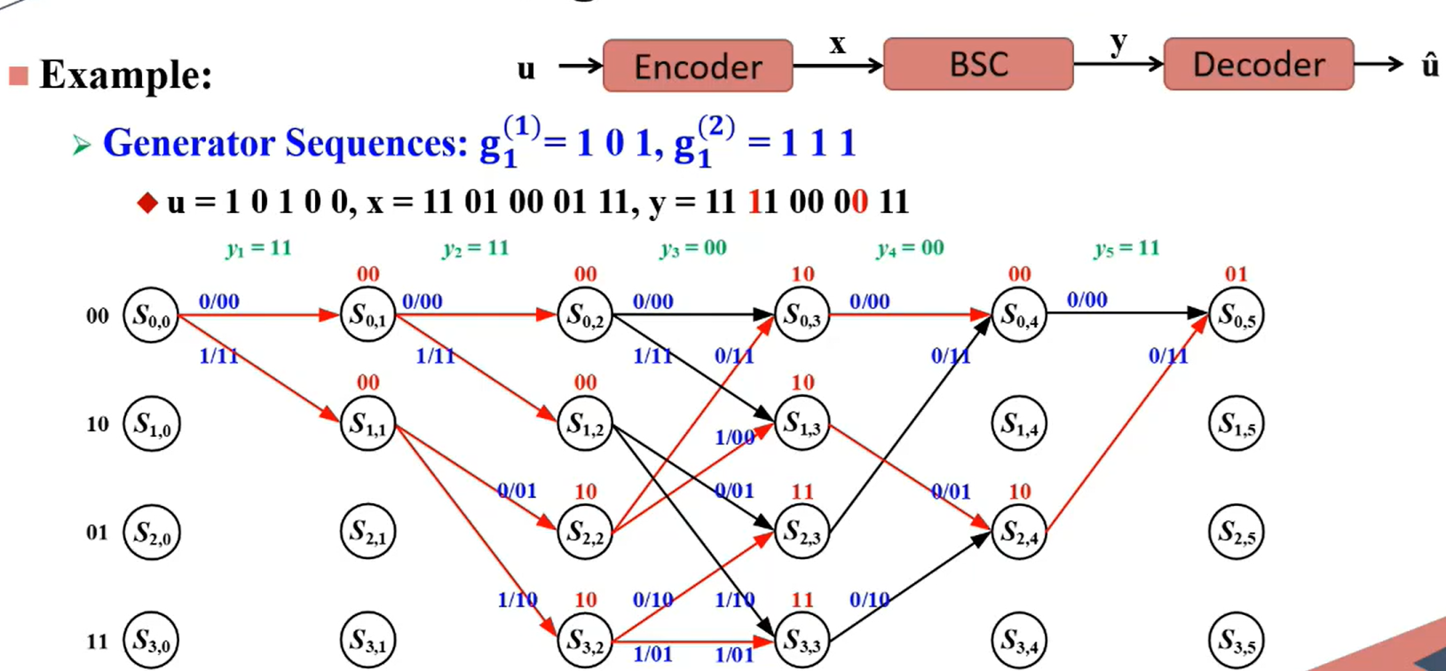

Slide 38
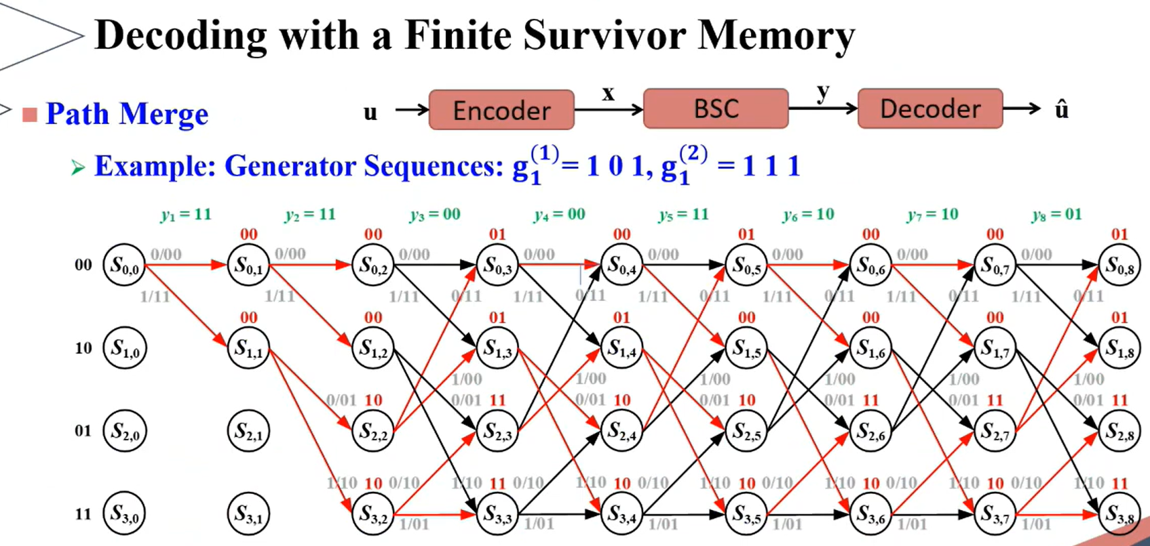

Slide 39
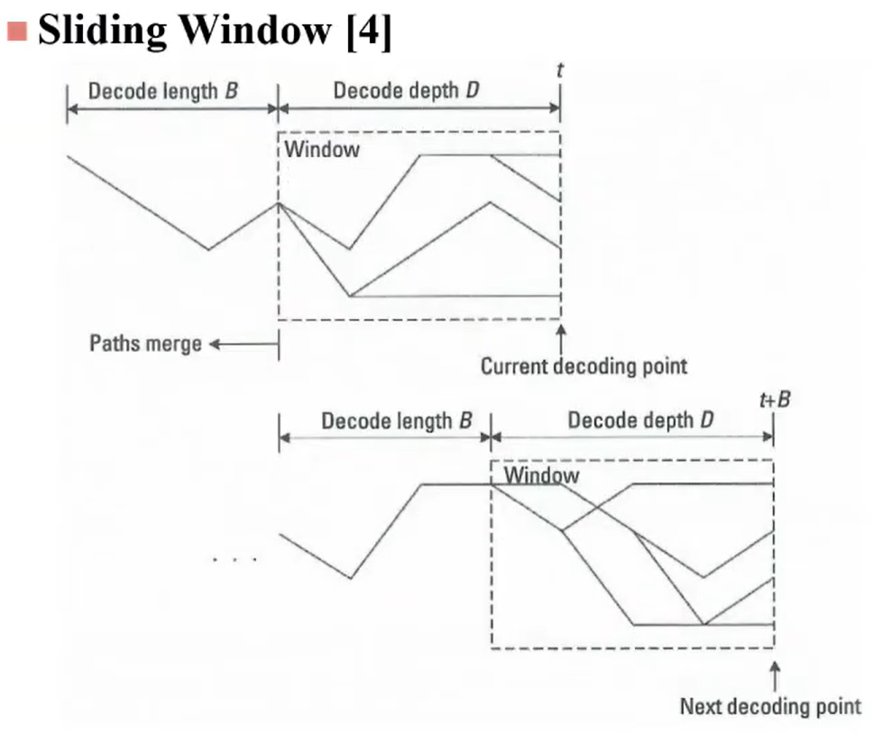

Slide 40
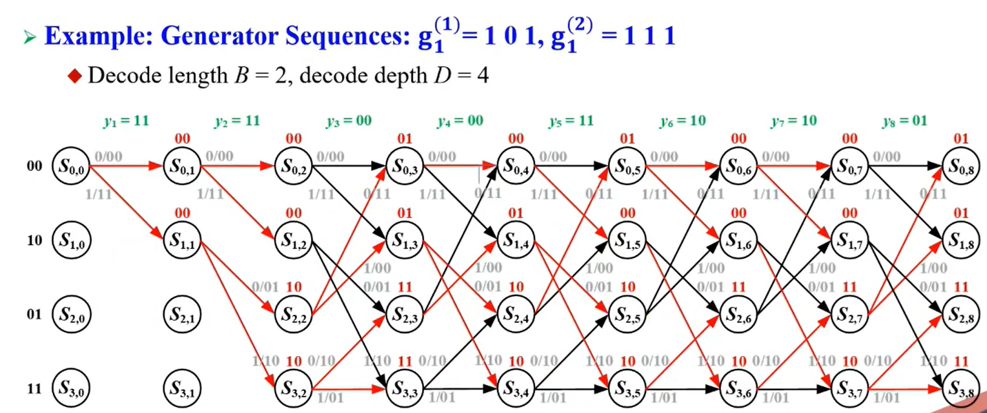

Slide 41
MATLAB : vitdec function

Slide 42
在 Viterbi 解碼中，Traceback Decoding（回溯解碼） 和 Register-Exchange Decoding（寄存器交換解碼） 是兩種不同的實現方式。MATLAB 的 vitdec 函數提供了三種模式：'trunc'、'cont' 和 'term'。以下是這三種模式的行為，以及它們與 Traceback Decoding 和 Register-Exchange Decoding 的對應關係：
1. 'trunc' 模式（Truncated Mode）
行為：假設輸入數據是固定長度的塊。解碼器從初始狀態開始，解碼完整個數據塊後，直接輸出解碼結果。不進行回溯，也不保存路徑歷史。
解碼方式：這種模式通常使用 Register-Exchange Decoding。解碼器在每個時間步驟直接更新每個狀態的路徑，並在解碼完成後選擇最終狀態的最佳路徑。
2. 'cont' 模式（Continuous Mode）
行為：假設輸入數據是連續的數據流。解碼器保存每個狀態的路徑歷史（path_history）。在解碼完成後，通過回溯路徑歷史來確定最可能的路徑。
解碼方式：這種模式使用 Traceback Decoding。解碼器在每個時間步驟保存每個狀態的最佳前一個狀態，並在解碼完成後回溯路徑。
3. 'term' 模式（Terminated Mode）
行為：假設輸入數據已經被終止（即最終狀態是已知的，通常是 00）。解碼器從初始狀態開始，解碼完整個數據塊後，從已知的最終狀態回溯路徑。
解碼方式：這種模式使用 Traceback Decoding。解碼器保存每個狀態的路徑歷史，並在解碼完成後從已知的最終狀態回溯路徑。

Slide 43
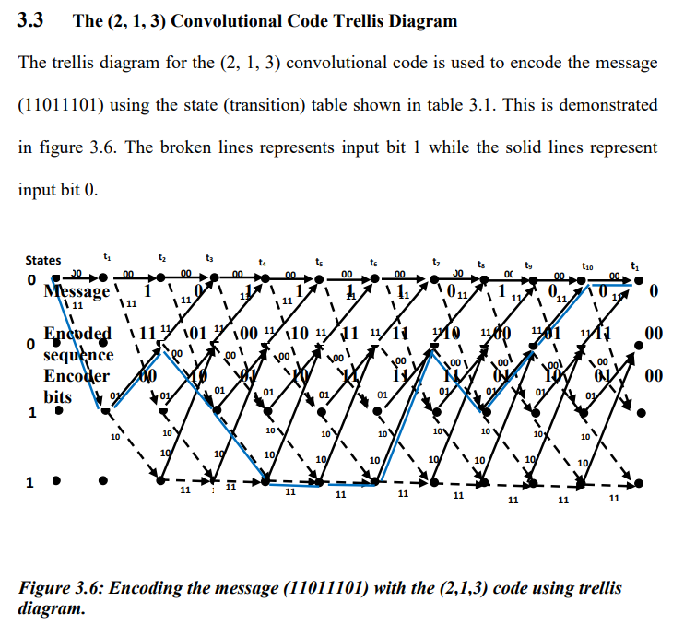
(2, 1, 3) 卷積碼的網格圖
表3.1 所示的狀態（轉移）表用於透過 (2, 1, 3) 卷積碼的網格圖對訊息 (11011101) 進行編碼，具體示例如圖6 所示。其中，虛線表示輸入位元為1，實線表示輸入位元為0。

Slide 44

FPGA Implementation of Convolutional Encoder and Adaptive Viterbi Decoder
B. SWETHA REDDY1 , K. SRINIVAS2
1 PG Scholar, Dept of ECE, Aurora’s Technological and Research Institute, JNTU Hyderabad, Telangana, India, E-mail:swetha.basireddy.15@gmail.com.
2Assistant Professor, Dept of ECE, Aurora’s Technological and Research Institute, JNTU Hyderabad, Telangana, India, E-mail: kotha.srinivas.428@gmail.com.

Slide 45
II. LITERATURE SURVEY
The Viterbi algorithm is an optimum decoding technique. It is optimum as it results in the minimum probability of error. It is also the relatively straight algorithm to implement in hardware and is the best decoding technique. Viterbi algorithm is a maximum likelihood algorithm and performs decoding, through searching the minimum cost path in a weighted oriented graph, called trellis [3].
The basic building blocks of Viterbi decoder are branch metric unit (BMU), path metric unit (PMU), add compare and select unit (ACSU) and state machine control unit (SMC). However, the complexity of the Viterbi decoder increases exponentially with the constraint length, so it is impractical to use codes with constraint lengths more than K>15 (3 to 9is common practice) [1]. Viterbi decoders employed in digital wireless communications are complex and dissipate large power. Sometimes, due to incomplete design space exploration or incorrect analysis, a suboptimal design is chosen. This work analyzes the design complexity by applying most of the known VLSI implementation techniques for hard-decision Viterbi decoding to a different set of code parameters.

Slide 46
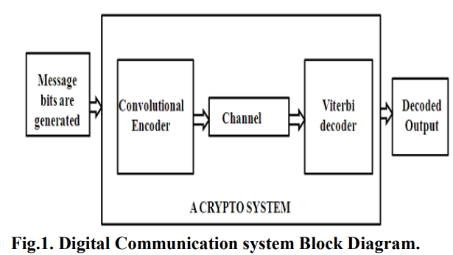
II. LITERATURE SURVEY
The Convolutional Encoder and Viterbi Decoder used in the Digital Communications System is shown in Fig. 1

Slide 47
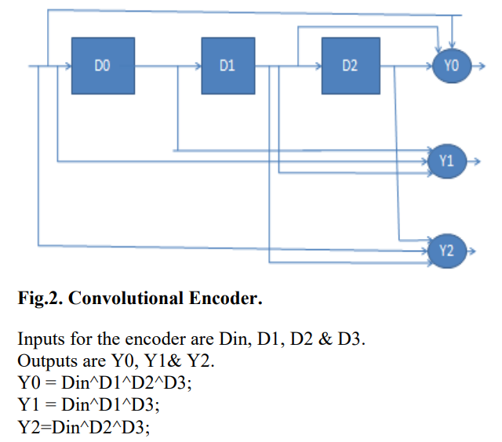
III. CONVOLUTIONAL ENCODER
The shift register has a constraint length (K) of 7, equal to the number of stages in the register. The output from the encoder is called code symbols. At initialization all stages in the encoder shall be initially set to zero. The output of the encoder is determined by the generator polynomial equations. Since the complexity of the encoder increases exponentially with the constraint length, none of the encoders uses more than a constraint length of 9, for practical reasons. [9] - [11].

Slide 48
IV. VITERBI ALGORITHM
The two techniques for decoding the data are trace back (TB) method and Register Exchange (RE) method. TB method is used for longer constraint lengths but is has larger decoding time. Also extra circuitry is required to reverse the decoded bits. The RE method is simpler and faster than the TB method for implementing the VD. RE method is not appropriate for decoders with long constraint lengths. Viterbi algorithm was introduced in 1967 by Viterbi. Viterbi algorithm is called as optimum algorithm because it minimizes the probability of error.
Notes:
解碼資料的兩種技術是回溯（TB）方法和暫存器交換（RE）方法。 TB 方法適用於較長的約束長度，但解碼時間較長。還需要額外的電路來逆轉解碼的位元。 RE 方法比 TB 方法實現 VD 更簡單、更快捷。 RE 方法不適用於約束長度較長的解碼器。維特比演算法是由維特比於1967年提出的。維特比演算法被稱為最優演算法，因為它最小化了出錯的機率。

Slide 49
IV. VITERBI ALGORITHM
The algorithm can be broken down into the following three steps.
Weigh the trellis; that is, calculate the branch metrics.
Recursively computes the shortest paths to time n, in terms of the shortest paths to time n-1. In this step, decisions are used to recursively update the survivor path of the signal. This is known as add-compare select (ACS) recursion.
Recursively finds the shortest path leading to each trellis state using the decisions from Step 2. The shortest path is called the survivor path for that state and the process is referred to as survivor path decode. Finally, if all survivor paths are traced back in time, they merge into a unique path, which is the most likely signal path [2]
Notes:
此演算法可分為以下三個步驟。
稱量棚架；即計算分支度量。
以到時間 n-1 的最短路徑為基準，遞迴計算到時間 n 的最短路徑。在此步驟中，決策用於遞歸更新訊號的倖存路徑。這被稱為加法-比較選擇 (ACS) 遞歸。
使用步驟 2 中的決策，遞歸地找到通往每個網格狀態的最短路徑。最後，如果所有倖存路徑都按時間回溯，它們會合併成一條唯一的路徑，這就是最可能的訊號路徑[2]

Slide 50
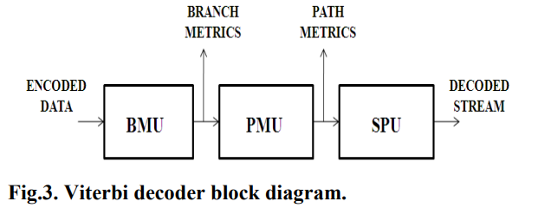
V. VITERBI DECODER ARCHITECTURE
A Viterbi decoder uses the VA for decoding a bit stream that has been encoded using FEC based on a convolutional code.
The Viterbi Decoder is used in many FEC applications and in systems where data are transmitted and subject to errors before reception.
The VA is commonly used in a wide range of communications and data storage applications. It is used for decoding convolutional codes, in base band detection for wireless systems, and also for detection of recorded data in magnetic disk drives.
The requirements for the Viterbi decoder or Viterbi detector, which is a processor that implements the VA, depend on the applications where they are used. The block diagram of Viterbi decoder is shown
in Fig.3.
Notes:
維特比解碼器使用 VA 對使用基於卷積碼的 FEC 編碼的位元流進行解碼。
維特比解碼器用於許多 FEC 應用程式以及資料傳輸且在接收之前容易出現錯誤的系統中。
VA 通常用於各種通訊和資料儲存應用。它用於解碼卷積碼、無線系統的基頻檢測以及磁碟機中記錄資料的檢測。
對於維特比解碼器或維特比檢測器（即實現 VA 的處理器）的要求取決於它們的應用場合。維特比譯碼器的框圖如下
如圖3所示。

Slide 51
V. VITERBI DECODER ARCHITECTURE
A. The Branch Metric Calculation (BMC)
This is typically based on a look-up table containing the various bit metrics. The computer looks up the n-bit metrics associated with each branch and sums them to obtain the branch metric. The result is passed along to the path metric Calculation. The responsibility of this unit is to compute the Hamming code between the expected code and the receiving code as a frame. At each processing, the BMU finds the Hamming code for these symbols.
Notes:
分支度量計算（BMC）
這通常是基於包含各種位元度量的查找表。電腦尋找與每個分支相關的 n 位元度量，並將它們相加以獲得分支度量。結果被傳遞到路徑度量計算。本單元的職責是計算預期代碼和接收代碼之間的漢明碼作為一幀。在每次處理時，BMU 都會找到這些符號的漢明碼。

Slide 52
V. VITERBI DECODER ARCHITECTURE
B. Path Metric Calculation
There are Path Metric Unit (PMU) and Add Compare Select Unit (ACSU) blocks in it.
Path Metric Unit (PMU): It computes the partial path metrics at each node in the trellis.
Add Compare Select Unit (ACSU): This ACSU is the main unit of the survivor path decoder. The function of this unit is to find the addition of the Hamming code received from BMU's and to compare the total Hamming code. This takes the branch metrics computed by the BMC and computes the partial path metrics at each node in the trellis. The surviving path at each node is identified, and the information-sequence updating and storage unit notified accordingly. Since the entire trellis is multiple images of the same simple element, a single circuit called Add- Compare-Select may be assigned to each trellis state.
Notes:
B. 路徑度量計算
其中有路徑度量單元 (PMU) 和新增比較選擇單元 (ACSU) 區塊。
路徑度量單元（PMU）：它計算網格中每個節點的部分路徑度量。
新增比較選擇單元 (ACSU)：此 ACSU 是倖存路徑解碼器的主要單元。該單元的功能是找出從 BMU 收到的漢明碼的和，並與總漢明碼進行比較。這採用 BMC 計算的分支度量並計算網格中每個節點的部分路徑度量。識別每個節點的倖存路徑，並相應地通知資訊序列更新和儲存單元。由於整個網格是同一簡單元素的多個影像，因此可以為每個網格狀態指派一個稱為「新增-比較-選擇」的電路。

Slide 53
V. VITERBI DECODER ARCHITECTURE
C. Survivor Management Unit (SMU)
This is responsible for keeping track of the information bits associated with the surviving paths designated by the path metric Calculation. There are two basic design approaches: Register Exchange and Trace Back. In both techniques, a shift register is associated with every trellis node throughout the decoding operation. Since one of the major interests is the low power design, the proposed decoder has been implemented using the trace back approach which dissipates less power. The major disadvantage of the RE approach is that its routing cost is very high especially in the case of long-constraint lengths and it requires much more resources.
Notes:
C. 倖存者管理單位（SMU）
它負責追蹤與路徑度量計算指定的倖存路徑相關的資訊位元。有兩種基本的設計方法：暫存器交換和回溯。在這兩種技術中，在整個解碼操作過程中，移位暫存器與每個網格節點相關聯。由於主要興趣之一是低功耗設計，因此提出的解碼器是使用功耗較低的回溯方法實現的。 RE 方法的主要缺點是其路由成本非常高，尤其是在長約束長度的情況下，並且需要更多的資源。

Slide 54
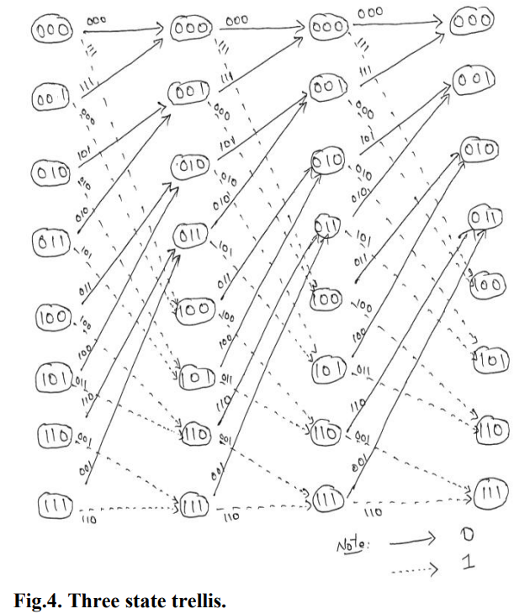
V. VITERBI DECODER ARCHITECTURE
D. Trellis Diagram
A trellis diagram is a time-indexed version of a state machine, and the simplest 3-state trellis is shown in fig.4. Each state corresponds to a possible pattern of recently received data bits and each branch corresponds to a receipt of the next (noisy) input. The goal is to find the path through the trellis of maximum likelihood, because that path corresponds to the most likely pattern that the transmitter actually sent.
Notes:
D. 網格圖
網格圖是狀態機的時間索引版本，最簡單的 3 狀態網格如圖 4 所示。每個狀態對應於最近接收的資料位元的可能模式，每個分支對應於下一個（雜訊）輸入的接收。目標是找到通過最大似然網格的路徑，因為該路徑對應於發射機實際發送的最可能的模式。

Slide 55


VI. RESULTS
A. Simulation Result
The Figs.5, 6 and 7 are the simulation result of the convolutional encoder. The first signal represents the input data given to the encoder. The next signal is the reset signal and next one is the clock signal that enables the process of the block. The signals after the clock signal represent the output with different combinations of input.
Fig.5. Simulation wave form Encoder.
Fig.6. Simulation wave form of viterbi Decoder.

Slide 56

VI. RESULTS

Slide 57
VII. CONCLUSION
In this paper, we have presented the design and implementation of the Convolutional encoder and Viterbi decoder for k/n=1/3. The given input sequence has been encoded by using convolutional encoder and it is transmitted through the channel. Finally, the transmitted sequence is decoded by the Viterbi decoder and the estimated original sequence is produced. The Viterbi decoder consists of major blocks of Trellis coded modulation (TCM), Branch metric unit (BMU), path metric unit (PMU), survivor path unit (SPU). This design has been simulated and synthesized using XILINX-ISE 13.2 for the constraint length of K=7 and code rate of 1⁄2 input sequence. It is implemented in FPGA Spartan 6 Board
Notes:
本文給出了k/n=1/3的捲積編碼器和維特比譯碼器的設計和實現。給定的輸入序列已使用卷積編碼器進行編碼並透過通道傳輸。最後，傳輸的序列由維特比譯碼器解碼並產生估計的原始序列。維特比譯碼器由網格編碼調變（TCM）、分支度量單元（BMU）、路徑度量單元（PMU）、倖存路徑單元（SPU）等主要模組組成。此設計已使用 XILINX-ISE 13.2 針對約束長度 K=7 和編碼率為 1⁄2 輸入序列進行了模擬和綜合。它在 FPGA Spartan 6 Board 中實現

Slide 58
IOSR Journal of VLSI and Signal Processing (IOSR-JVSP)
Volume 4, Issue 5, Ver. I (Sep-Oct. 2014), PP 46-53
e-ISSN: 2319 – 4200, p-ISSN No. : 2319 – 4197
www.iosrjournals.org
FPGA Implementation of Viterbi Algorithm for Decoding of
Convolution Codes
K.Santhosh Kumar1 M.V.H. Bhaskara Murthy2
1 (Department of E.C.E, Aditya Institute of Technology And Management, India)
2 (Department of E.C.E, Aditya Institute of Technology And Management, India)

Slide 59
ABSTRACT
The proposed design supports a generic, robust and configurable Viterbi decoder with constraint length of 7, code rate of 1/2 and decoding depth of 36 symbols.
The Viterbi decoder uses full-parallel structure to improve computational speed for the add-compare-select (ACS) modules, adopts optimal data storage mechanism to avoid overflow and employs three distributed RAM blocks to complete cyclic trace-back. It includes the core parts, for example, the state path measure computation, the preservation and transfer of the survivor path and trace-back decoding, etc. Compared to the general Viterbi decoder, this design can effectively decrease the 10% of chip logic elements, reduce 5% of power consumption, and increase the encoder and decoder working performance in the hardware implementation. Lastly, relevant simulation results using Verilog HDL language are verified based on a Xinlinx Virtex-II FPGA by ISE 7.1i. It is shown that the Viterbi decoder is capable of decoding (2, 1, 7) convolutional codes accurately with a throughput of 80 Mbps.
Notes:
所提出的設計支援通用、穩健且可配置的維特比解碼器，其約束長度為 7、碼率為 1/2、解碼深度為 36 個符號。
Viterbi譯碼器採用全平行結構提高加法-比較-選擇(ACS)模組的運算速度,採用最優資料儲存機制避免溢位,並採用三個分散式RAM區塊完成循環回溯。包含狀態路徑度量計算、倖存路徑的保存與傳遞、回溯譯碼等核心部分。在硬體實作上提高編碼器和解碼器的工作效能。最後,基於Xinlinx Virtex-II FPGA,利用ISE 7.1i軟體對採用Verilog HDL語言進行的相關模擬結果進行了驗證。結果表明，維特比譯碼器能夠準確解碼（2, 1, 7）卷積碼，吞吐量達到 80 Mbps。

Slide 60

Convolutional Encoder Analysis and Architecture
Notes:
所提出的設計支援通用、穩健且可配置的維特比解碼器，其約束長度為 7、碼率為 1/2、解碼深度為 36 個符號。
Viterbi譯碼器採用全平行結構提高加法-比較-選擇(ACS)模組的運算速度,採用最優資料儲存機制避免溢位,並採用三個分散式RAM區塊完成循環回溯。包含狀態路徑度量計算、倖存路徑的保存與傳遞、回溯譯碼等核心部分。在硬體實作上提高編碼器和解碼器的工作效能。最後,基於Xinlinx Virtex-II FPGA,利用ISE 7.1i軟體對採用Verilog HDL語言進行的相關模擬結果進行了驗證。結果表明，維特比譯碼器能夠準確解碼（2, 1, 7）卷積碼，吞吐量達到 80 Mbps。

Slide 61
The Architecture of the Viterbi Decoder
In this paper, hamming distance computation module, ACS module, survivor path storage and management module, trace-back module, timing controller module and minimum value choice module are included for the Viterbi decoder.
However, there are two remarkable problems before the design. One is the choice of decoding depth; the other is the survivor path storage.
In general, the VA starts to trace-back until the survivor path is to zero, and then finds a best path. But this would not only increase decoding delay, and will cause the problem of much bigger storage capacity. Despite the growing decoding depth can improve the decoding accuracy, according to former experiences the system performance has no significant influence when decoding depth is five times as much to 10 times of the registration numbers [9].
Notes:
本文針對維特比譯碼器設計了漢明距離運算模組、ACS模組、倖存路徑儲存與管理模組、回溯模組、時序控制器模組和最小值選擇模組。
然而，該設計面臨兩個顯著的問題。一是解碼深度的選擇；另一個是倖存者路徑儲存。
一般情況下，VA開始回溯，直到倖存路徑為零，然後找到一條最佳路徑。但這不僅會增加解碼延遲，還會造成儲存容量過大的問題。雖然增加解碼深度可以提高解碼準確率，但根據以往經驗，當解碼深度為註冊個數的5倍到10倍時，對系統效能影響不大[9]。

Slide 62

The Architecture of the Viterbi Decoder
Based on the 802.11a decoding depth is set to thirty six. Convolutional decoder has sixty four states, it needs to store the sixty four survivor paths and keep the corresponding path lengths. Therefore, the capacity of each RAM block should be set to sixty four storage units, the size of each storage unit equals to decoding depth.
The whole hardware architecture is shown in Figure 2.
Notes:
基於802.11a的解碼深度設定為三十六。卷積解碼器有64個狀態，需要儲存64個倖存路徑並保持對應的路徑長度。因此每個RAM塊的容量應設定為64個儲存單元，每個儲存單元的大小等於解碼深度。整個硬體架構如圖2所示。

Slide 63
The Architecture of the Viterbi Decoder
The proposed Viterbi decoder works as follows:
Step 1, two parallel binary bits are inputted into the Viterbi decoder with every clock pulse, and then the hamming distance computation module begins to work when the input enabling signal is valid. It calculates sixty four groups of hamming distance. Each group consists of two because each current state can be reached by two possible paths.
Step 2, the ACS modules begin to work.
Cumulative hamming distance one clock before is added to hamming distance of the new branch path correspondingly. After adding operation each current state gets two new cumulative hamming distances, and then the ACS module compares the size of the two cumulative distances and selects the smaller one as a survivor. The path of the survivor represents survived path. The smaller cumulative hamming distance becomes the benchmark for the next computation. Survivor paths of all the sixty four states are stored in RAM blocks.
Step 3, sixty four survivor paths are stored in the RAM blocks and each of them equals to decoding depth when the decoding depth is reached, then sixty four cumulative hamming distances are inputted into the minimum value choice module. This module outputs the minimum value to trace-back module, then the trace-back module reads survivor values from the paths storage RAM blocks according to survivor path values. The outputs of the backtracking module are the Viterbi decoding results.
Notes:
所提出的維特比譯碼器的工作原理如下：
步驟1、每個時脈向維特比譯碼器輸入兩個並行的二進位位，當輸入使能訊號有效時，漢明距離計算模組開始工作。它計算了六十四組漢明距離。每組由兩組組成，因為每個當前狀態都可以通過兩條可能的路徑到達。
第二步，ACS模組開始工作。將一個時鐘之前累積的漢明距離相應地添加到新分支路徑的漢明距離中。每個當前狀態經過加法運算後得到兩個新的累積漢明距離，然後ACS模組比較兩個累積距離的大小，選擇較小的一個作為倖存者。 survivor的path代表倖存的路徑。較小的累積漢明距離成為下次計算的基準。所有 64 個狀態的存活路徑均儲存在 RAM 區塊中。
步驟3，當解碼深度達到時，在RAM區塊中儲存64個倖存路徑，每條倖存路徑等於解碼深度，然後將64個累積漢明距離輸入到最小值選擇模組。此模組將最小值輸出給回溯模組，然後回溯模組根據倖存路徑值從路徑儲存RAM區塊讀取倖存值。回溯模組的輸出是維特比譯碼的結果。

Slide 64


3.2.1. The Hamming Distance Computation Module
This module compares the received codes with the expected codes of the current state and calculates the hamming distance between them. The hamming distance computation schematic diagram is shown in Figure 3.
Table 1 gives the algorithm expressions for the hamming distance calculation of two received codes under the four possible values of the excepted codes, where data_in1 and data_in2 stand for the two-bit inputs in the trellis.
Notes:
此模組將接收到的程式碼與目前狀態的預期程式碼進行比較，並計算它們之間的漢明距離。漢明距離計算示意圖如圖3所示。
表1給出了在預期編碼的四種可能值下，兩個接收編碼的漢明距離計算的演算法表達式，其中data_in1和data_in2代表網格中的兩位輸入。

Slide 65

3.2.2. ACS Module
This module is the core part of the Viterbi decoder to complete addition, comparison and selecting function.
There are sixty four states in the decoder; each state uses an ACS module. So the decoder needs sixty four ACS modules. Parallel processing is used for this module. This design cannot only improve the computational speed, but also reduce the system delay. The most important is relatively simple hardware implementation. In addition, a counter with thirty six counting cycles is designed to start the ACS module and measure time. With more and more input bits, cumulative hamming distance is also on the rise. This brings trouble to memory storage. In order to prevent overflow, cumulative hamminAg distance is moved two bits wide rightwards. Before decoding, in order to guarantee the all-zero state is the first choice, the cumulative hamming distance of all-zero state is initialized to zero, while the rest take higher values. Eight is set in other states. The hardware architecture of the ACS module is shown in Figure 4.
Notes:
此模組是維特比譯碼器的核心部分，完成加法、比較和選擇功能。
解碼器中有六十四種狀態；每個州都使用一個 ACS 模組。因此解碼器需要六十四個ACS模組。本模組採用並行處理。這種設計不僅可以提高運算速度，而且可以減少系統延遲。最重要的是相對簡單的硬體實作。此外，還設計了一個具有三十六個計數週期的計數器來啟動ACS模組並測量時間。隨著輸入位數越來越多，累積漢明距離也增加。這給記憶儲存帶來麻煩。為了防止溢出，累積漢明距離向右移動兩位。譯碼前，為了確保全零狀態為首選，將全零狀態的累積漢明距離初始化為零，其餘狀態取較大值。其他州則有八個。 ACS模組的硬體架構如圖4所示。

Slide 66
3.2.2. ACS Module
Notes:
此模組是維特比譯碼器的核心部分，完成加法、比較和選擇功能。
解碼器中有六十四種狀態；每個州都使用一個 ACS 模組。因此解碼器需要六十四個ACS模組。本模組採用並行處理。這種設計不僅可以提高運算速度，而且可以減少系統延遲。最重要的是相對簡單的硬體實作。此外，還設計了一個具有三十六個計數週期的計數器來啟動ACS模組並測量時間。隨著輸入位數越來越多，累積漢明距離也增加。這給記憶儲存帶來麻煩。為了防止溢出，累積漢明距離向右移動兩位。譯碼前，為了確保全零狀態為首選，將全零狀態的累積漢明距離初始化為零，其餘狀態取較大值。其他州則有八個。 ACS模組的硬體架構如圖4所示。

Slide 67
3.2.3. Survivor Path Storage and Management Module
This module is used for storing and managing survivor path values of the ACS modules. Three RAM blocks work by turns. The following is a detailed description.
Step 1, the first RAM block is written to survivor paths for sixty six clock periods which equals to decoding depth, and then it begins to trace-back and decode.
Step 2, the second RAM block begins to be written to survivor paths like the first one. After another decoding depth the second one begins to trace-back and the third one begins to be written to survivor paths.
Step 3, when the third RAM block is full, it begins to trace-back. At this time the first RAM block is free, therefore, the survivor paths can be written to it again.
In this study, decoding and trace-back is performed at the same time. Three RAM blocks are used for this module because the write operation and read operation are not the same start and end. When the decoding depth is reached in the first RAM block, sixty four cumulative hamming distances of all the states are inputted to the minimum value choice module; this module needs thirty three clock periods to finish the work. In this period the second one is being written. The first RAM block just starts decoding when the second one is full. If the first one that should be written is not free when the write operation of the second one is over, the third RAM block should be provided for the new write operation. Therefore, two RAM blocks cannot be used by turns. The working process of RAM blocks is showed in Figure 5.
Notes:
此模組用於儲存和管理ACS模組的倖存路徑值。三個 RAM 塊輪流工作。以下進行詳細的介紹。
步驟1，將第一個RAM區塊寫入存活路徑66個時脈週期（相當於解碼深度），然後開始回溯和解碼。
第 2 步，第二個 RAM 區塊開始像第一個​​一樣寫入倖存路徑。在另一個解碼深度之後，第二個解碼深度開始回溯，第三個解碼深度開始寫入存活路徑。
步驟3，當第三個RAM塊寫滿時，開始回溯。此時第一個 RAM 區塊是空閒的，因此可以將倖存路徑再次寫入其中。
本研究中，解碼和回溯同時進行。這個模組使用了三個 RAM 區塊，因為寫入操作和讀取操作的開始和結束時間不一樣。當在第一個RAM區塊中達到解碼深度時，所有狀態的64個累積漢明距離被輸入到最小值選擇模組；此模組需要三十三個時脈週期才能完成工作。在此期間，第二本書正在寫作中。當第二個 RAM 區塊已滿時，第一個 RAM 區塊才開始解碼。如果在第二個 RAM 區塊的寫入作業結束時，第一個需要寫入的 RAM 區塊沒有空閒，則應該為新的寫入作業提供第三個 RAM 區塊。因此，兩個 RAM 塊不能輪流使用。 RAM塊的工作過程如圖5所示。

Slide 68

3.2.3. Survivor Path Storage and Management Module
Notes:
此模組用於儲存和管理ACS模組的倖存路徑值。三個 RAM 塊輪流工作。以下進行詳細的介紹。
步驟1，將第一個RAM區塊寫入存活路徑66個時脈週期（相當於解碼深度），然後開始回溯和解碼。
第 2 步，第二個 RAM 區塊開始像第一個​​一樣寫入倖存路徑。在另一個解碼深度之後，第二個解碼深度開始回溯，第三個解碼深度開始寫入存活路徑。
步驟3，當第三個RAM塊寫滿時，開始回溯。此時第一個 RAM 區塊是空閒的，因此可以將倖存路徑再次寫入其中。
本研究中，解碼和回溯同時進行。這個模組使用了三個 RAM 區塊，因為寫入操作和讀取操作的開始和結束時間不一樣。當在第一個RAM區塊中達到解碼深度時，所有狀態的64個累積漢明距離被輸入到最小值選擇模組；此模組需要三十三個時脈週期才能完成工作。在此期間，第二本書正在寫作中。當第二個 RAM 區塊已滿時，第一個 RAM 區塊才開始解碼。如果在第二個 RAM 區塊的寫入作業結束時，第一個需要寫入的 RAM 區塊沒有空閒，則應該為新的寫入作業提供第三個 RAM 區塊。因此，兩個 RAM 塊不能輪流使用。 RAM塊的工作過程如圖5所示。

Slide 69
3.2.4. Minimum Value Choice Module
This module compares the size of sixty four cumulative hamming distances when the decoding depth is reached. Its aim is to obtain the minimum value and the initial state of trace-back. The working time of the minimum value choice module cannot be greater than the decoding depth; otherwise the decoding errors will occur. This module consists of two same comparison units; the first comparison unit compares the size of the former thirty two cumulative hamming distances, the second one compares the size of the remaining thirty two cumulative hamming distances. Finally the result of the first comparison unit is compared with the second one, and then the minimum value is achieved. The whole process needs thirty three clock cycles, which is less than the decode depth.
However, the delay with thirty three clock cycles is made due to using two parallel comparators. More comparators can be designed for reducing delay, while the more resources and area will be occupied. The design should be carefully weighed between the delay and resource consumption.
Notes:
此模組用於儲存和管理ACS模組的倖存路徑值。三個 RAM 塊輪流工作。以下進行詳細的介紹。
步驟1，將第一個RAM區塊寫入存活路徑66個時脈週期（相當於解碼深度），然後開始回溯和解碼。
第 2 步，第二個 RAM 區塊開始像第一個​​一樣寫入倖存路徑。在另一個解碼深度之後，第二個解碼深度開始回溯，第三個解碼深度開始寫入存活路徑。
步驟3，當第三個RAM塊寫滿時，開始回溯。此時第一個 RAM 區塊是空閒的，因此可以將倖存路徑再次寫入其中。
本研究中，解碼和回溯同時進行。這個模組使用了三個 RAM 區塊，因為寫入操作和讀取操作的開始和結束時間不一樣。當在第一個RAM區塊中達到解碼深度時，所有狀態的64個累積漢明距離被輸入到最小值選擇模組；此模組需要三十三個時脈週期才能完成工作。在此期間，第二本書正在寫作中。當第二個 RAM 區塊已滿時，第一個 RAM 區塊才開始解碼。如果在第二個 RAM 區塊的寫入作業結束時，第一個需要寫入的 RAM 區塊沒有空閒，則應該為新的寫入作業提供第三個 RAM 區塊。因此，兩個 RAM 塊不能輪流使用。 RAM塊的工作過程如圖5所示。

Slide 70
3.2.5. Trace-Back Module
There are two algorithms of survivor paths storage and management for decoding. One is register-exchange algorithm; the other is trace-back.
The principles and hardware implementation of the register-exchange algorithm [10,11] are more easily. Compared with trace-back, this algorithm has one obvious advantage that is the smaller output delay. But it brings two mortal flaws, one is lots of power consumption when the memory contents of each state are always read and written for updating survivor paths with every clock pulse, the other is too complex internal connection relationships to restrict the FPGA design. So it is rarely used in practical applications. Trace-back is a classic algorithm and widely used, and uses memories to store survivor paths of each state.
The former trace-back point is determined by the best initial state and the corresponding survivor paths every clock. The trace-back is completed after thirty six clock periods. The hardware structure of the algorithm is simple to manage and control for FPGA.
Notes:
解碼的倖存路徑儲存和管理有兩種演算法。一是暫存器交換算法；另一個是追溯。
暫存器交換演算法[10,11]的原理和硬體實作比較容易。與回溯演算法相比，此演算法一個明顯的優勢就是輸出延遲較小。但它也帶來兩個致命的缺陷，一是每個時脈都要讀寫各個狀態的記憶體內容來更新倖存路徑，從而造成很大的功耗；二是內部連結關係過於複雜，限制了FPGA的設計。所以實際應用很少採用。回溯演算法是一種經典且被廣泛使用的演算法，它使用記憶體來儲存各個狀態的倖存路徑。
每個時鐘透過最佳初始狀態和對應的倖存路徑確定前一個回溯點。三十六個時鐘週期後回溯完成。此演算法的硬體結構簡單，便於FPGA管理與控制。

Slide 71

3.2.5. Trace-Back Module
As shown in Figure 6, from the K moment to K + 1 moment, there are two optional paths to reach the state 000000 and they originate from the state 000000 and 000001. There is a difference between the lowest orders of the two states; the lowest order stands for the input bit of the Viterbi encoder five clock pulses before, the rest bits represent others from different moments.
The top digit of the state 000000 is the survivor value at the K + 1 moment.It indicates the input bit in the K + 1 moment, in other words, also the decoded value. All these survivor values constitute the only survivor path. A counter with thirty six count cycles is designed for recording the trace-back time to determine the trace-back end. Survivor paths are extracted for updating the next trace-back point according to the current one. The Viterbi decoder begins to output when the counter counts to the decoding depth. In addition, the decoding sequences of trace-back are opposite to the practical ones, so adjustments should be made during outputting.
Notes:
如圖6所示，從K時刻到K+1時刻，到達狀態000000有兩條可選路徑，分別源自狀態000000和000001，兩個狀態的最低階數有所差異；最低位元代表5個時脈之前維特比編碼器的輸入位，其餘位元代表不同時刻的其他位元。
狀態000000的最高位是K+1時刻的存活值，它表示K+1時刻的輸入位，換句話說，也是解碼後的值。所有這些倖存值構成了唯一的倖存路徑。設計了一個具有三十六計數週期的計數器用於記錄回溯時間以確定回溯的結束。提取倖存路徑，以便根據目前回溯點更新下一個回溯點。當計數器計數到解碼深度時，維特比譯碼器開始輸出。另外，回溯的解碼順序與實際的解碼順序相反，輸出時需要調整。

Slide 72


Results Analysis
本篇:
XC2V2000-4BFG957C FPGA 採用了 0.15 µm / 0.12 µm CMOS 8-layer metal process 製程技術。
120nm/150nm 80Mbps
賴老師晶創文案: 目前VD設計在Virtex-6/7 FPGA 40nm/20nm製程可以在3.32–4.62ns完成一次解碼，操作頻率可達216–301 MHz、吞吐量則為301–433 Mbps [3.1, 3.2]

Slide 73
本篇問題點
這篇很完整，目前看起來文中所提及的”基於802.11a的解碼深度設定為36”這部分與matlab所定義的A rate 1/2 code has a traceback depth of 5(ConstraintLength – 1).不一樣因為照文中帶入應該是 5*(7-1) = 30
文中” constraint length of 7, code rate of 1/2 and decoding depth of 36 symbols. 這意思也是說會有64種狀態，會有18個blocks

Slide 74
Design and Implementation of High Speed Viterbi
Decoder and Convolution Encoder for SDR
Indian Journal of Science and Technology, Vol 12(36), DOI:10.17485/ijst/2019/v12i36/147574, September 2019
R. J. Reshmi* and C. Raji
School of ECE, REVA University, Bangalore – 560064, Karnataka, India; reshuachu26@gmail.com, raji.c@reva.edu.in

Slide 75


Slide 76

Methodology
The Viterbi decoder comprised of following major block:

Slide 77
2.1 BMU
The purpose of the BM unit is to determine branch metric state values. The hard decision type decoder is taken using the hamming distance metric values are computed. It executes the EX-OR operation between each state’s possible output symbol and the symbol received
2.2 ACSU
The ACSU consists of Comparator, Multiplexer and adder.
The state metric is the sum of the minimum value of previous state metric at that state and current branch metric. Adder adds the previous state of the state metric and branch metric of the current state. At each state the state metric value is compared using comparator and multiplexer selects the state metric with the minimum value.
2.3 PMU
PMU is the summation of the pervious iteration of path metric and the current input of the branch metric. At each node of trellis the partial path metric is computed and branch metric computed at the BMU is taken. The memory element stores the metric for next iteration and to find the path metric with minimum value at the last stage (iteration) of the trellis.
2.4 TBU
TBU recognise the output and survivor path. The original bit given to the convolutional encoder is extracted by the trace back unit.
The Computation of Hamming Distance ModuleThis module differentiates the obtained codes with the actual expected input codes of the current state in order to calculate the hamming distance between them. Figure 5 shows the schematic diagram for calculating the hamming distance.
Notes:
BM單元的目的是確定分支度量狀態值。採用硬判決類型解碼器，計算漢明距離度量值。它在每個狀態可能的輸出符號和接收到的符號之間執行 EX-OR 運算
ACSU 由比較器、多工器和加法器組成。
狀態度量是該狀態下前一個狀態度量的最小值與目前分支度量之和。加法器將狀態度量的前一個狀態與目前狀態的分支度量相加。在每個狀態下，使用比較器比較狀態度量值，然後多工器選擇具有最小值的狀態度量。
PMU 是前一次迭代的路徑度量與目前輸入的分支度量的總和。在網格的每個節點處計算部分路徑度量，並採用在 BMU 處計算的分支度量。儲存元件儲存下一次迭代的度量，並在網格的最後階段（迭代）找到具有最小值的路徑度量。
TBU 識別輸出和倖存者路徑。給予卷積編碼器的原位元由回溯單元擷取。
漢明距離計算模組該模組將獲取的編碼與當前狀態的實際預期輸入編碼進行區分，以計算它們之間的漢明距離。圖5為漢明距離計算示意圖。

Slide 78


Methodology

Slide 79
3. Viterbi Algorithm
1. Trellis is weighed. Branch metrics are calculated.
2. In terms of the minimum path to n time, recursively calculate the minimum path to n-1 time. Procedure has been used in this step to repeatedly refresh the signal survivor path. This is called the recursion Add Compare Select (ACS).
3. Iteratively find the shortest distance that uses Step 2 decisions leads to each trellis state. Survivor path decoding finds the shortest path for the state. Lastly, the survivor paths incorporate the most likely signal path into a unique path when they are traced back in time. The flow chart for the Viterbi algorithm is shown in the Figure 6.
Notes:
1. 對棚架進行稱重。計算分支指標。
2.針對n次的最小路徑，遞歸計算n-1次的最小路徑。此步驟中已使用程式重複刷新訊號倖存路徑。這被稱為遞歸添加比較選擇（ACS）。
3. 迭代地找出使用步驟 2 決策到達每個網格狀態的最短距離。倖存者路徑解碼尋找該狀態的最短路徑。最後，當回溯時間時，倖存路徑會將最可能的訊號路徑合併為一條唯一路徑。 Viterbi演算法的流程圖如圖6所示。

Slide 80

3. Viterbi Algorithm

Slide 81


4. Result and Discussion

Slide 82

4. Result and Discussion

Slide 83


4. Result and Discussion

Slide 84
本篇問題點
該文獻並沒有提到trackback 深度是多少 ?
該文獻圖五來源跟上一篇文獻一模一樣，圖五名稱還是在講漢明距離架構?
圖11 Viterbi RTL看起來 vit_data_out 只有解8 bit 這樣意思是只有8 個symbol，這部分等於說本篇的解碼架構只有8個block，trackback 看起來也是一次解完，才做trackback

Slide 85



綜合上述文獻比較
FPGA Implementation of Viterbi Algorithm for Decoding of Convolution Codes:
(2,1,7)
XC2V2000-4BFG957C FPGA 採用了 0.15 µm / 0.12 µm CMOS 8-layer metal process 製程技術。
120nm/150nm 80Mbps
$$\frac{112000Mbps}{80Mbps}=1400$$
Design of High-Speed Viterbi Decoders on Virtex-6 FPGAs:
Code rate(1/3) VD設計在Virtex-6/7 FPGA 40nm/20nm製程可以在3.32–4.62ns完成一次解碼，操作頻率可達216–301 MHz、吞吐量則為301–433 Mbps [3.2]
$$\frac{112000Mbps}{433Mbps}=258$$
Design and Implementation of High Speed Viterbi Decoder and Convolution Encoder for SDR:
(2,1,3) Xilinx FPGA SPARATAN 3AN 90nm 561.798Mhz
$$\frac{112000Mbps}{561.798Mbps}=199$$

Slide 86
International Journal of Science and Research (IJSR) ISSN (Online): 2319-7064
Design and Implementation of Convolutional
Encoder and Parallel Processing Viterbi Decoder
Using Verilog
Vinay .B .K1 Sunil .M .P2
1M.Tech Student (SP & VLSI) Department of Electronics and Communication Engineering, Jain University, Karnataka, India
2Assistant Professor, Department of Electronics and Communication Engineering, Jain University, Karnataka, India

Slide 87

1.Introduction
The one is used for comparing signal bit and the other is used for comparing data bits. The advantage of this design is considerably reducing the circuit timing delay.
The core unitof this design is the TB (Trace Back) and decoder, which include two function modules. The one is TB that read the information of the survivor paths in the memory. The other is decoder that computes the output results. These two modules work simultaneously but in different memory address. In this way, the Viterbi decoder is more efficient than a normal one because the decoder do not need to wait for TB
Notes:
一個用來比較訊號位，另一個用來比較資料位。這種設計的優點是大大減少了電路時序延遲。
本設計的核心單元是TB（Trace Back）和解碼器，包括兩個功能模組。一個是TB，讀取記憶體中的倖存路徑的資訊。另一個是計算輸出結果的解碼器。這兩個模組同時工作，但是在不同的記憶體位址。這樣，維特比譯碼器比普通譯碼器更有效率，因為譯碼器不需要等待 TB

Slide 88

2. Convolutional Encoder

Slide 89
3.Viterbi Decoder Implementation
A Viterbi decoder is usually composed of three blocks. It consists of following blocks:
Branch Metric Unit(BMU)
Add Compare and Select Unit(ACSU)
Traceback Unit(TU) Each block is described in the following sub-sections.
Each block is described in the following sub-sections.

Slide 90

3.Viterbi Decoder Implementation
A.Branch Metric Unit (BMU)
This unit computes the Branch Metric (BM) for the received symbol. In case of hard decision, BM is taken as the Hamming distance between received symbol and the encoder output corresponding to a particular state transition. In case of soft decision, BM is taken as Euclidean distance. The BMU performs EX-OR operation on received symbols and expected symbols and counts the number of differed bits i,e. number of 1s, by which Hamming distance is obtained. The result is fed as input to the Add Compare and Select Unit. Figure 3 shows Branch metric computation block.
Notes:
此單元計算接收符號的分支量測（BM）。在硬判決的情況下，BM 被視為接收符號與對應於特定狀態轉換的編碼器輸出之間的漢明距離。在軟決策的情況下，BM 被視為歐幾里德距離。 BMU 對接收符號和預期符號執行 EX-OR 運算，並計算不同位數，即。 1的個數，由此可得到漢明距離。將結果作為輸入提供給新增、比較和選擇單元。圖 3 顯示分支度量計算區塊

Slide 91
3.Viterbi Decoder Implementation
B.Add Compare and Select Unit (ACSU)
The Add Compare Select Unit (ACSU) carries the bulk of arithmetic processing of the Viterbi decoder. ACSU is also called as Path Metric Unit (PMU), as path metric is computed.
The main operations involved in the path metric computation are addition, comparison and selection. Figure 4 shows the link between a stage in the trellis diagram and the ACS unit. It can be noted that two ACS Unit that share the same inputs can be grouped in a Butterfly Unit.
The ACSU unit is composed of 4 ACS units, each is composed of an ACS butterfly module, which adds the corresponding BM to corresponding PM, compares the new PM, feeds the selected PM to ACSU unit and generates the decision bits. The decoder implements adders for computing the path metric and a compare select section to decide on the best path.
Notes:
新增比較選擇單元 (ACSU) 承擔了維特比解碼器的大部分算術處理任務。 ACSU 也稱為路徑度量單元 (PMU)，因為路徑度量是計算的。
路徑度量計算主要涉及的運算有加法、比較和選擇。圖 4 顯示了網格圖中某個階段與 ACS 單元之間的連結。值得注意的是，兩個共用相同輸入的 ACS 單元可以分組在一個蝴蝶單元中。
ACSU單元由4個ACS單元組成，每個ACS單元由一個ACS蝶形模組組成，該模組將相應的BM添加到相應的PM中，比較新的PM，將選定的PM饋送到ACSU單元並產生決策位。解碼器實作加法器來計算路徑度量，並實現比較選擇部分來決定最佳路徑。

Slide 92


3.Viterbi Decoder Implementation
B.Add Compare and Select Unit (ACSU)
Notes:
新增比較選擇單元 (ACSU) 承擔了維特比解碼器的大部分算術處理任務。 ACSU 也稱為路徑度量單元 (PMU)，因為路徑度量是計算的。
路徑度量計算主要涉及的運算有加法、比較和選擇。圖 4 顯示了網格圖中某個階段與 ACS 單元之間的連結。值得注意的是，兩個共用相同輸入的 ACS 單元可以分組在一個蝴蝶單元中。
ACSU單元由4個ACS單元組成，每個ACS單元由一個ACS蝶形模組組成，該模組將相應的BM添加到相應的PM中，比較新的PM，將選定的PM饋送到ACSU單元並產生決策位。解碼器實作加法器來計算路徑度量，並實現比較選擇部分來決定最佳路徑。

Slide 93
3.Viterbi Decoder Implementation
C.Traceback Algorithm
Traceback memory stores the history of decision bits from ACS operation. This memory is a two dimensional circular buffer, with rows and columns. The number of rows is equal to the number of states N = 2 K-1 where K is the constraint length.
Each column stores the results of N comparisons corresponding to incoming coded bits at each time interval. The number of columns is equal to the "Trace back depth (L)" defined below. Using the trace back operation, every state from a current time is followed backwards through its maximum likelihood path. All of the paths converge at a point somewhere previous point in time. The point at which the corrected bit streams starts is called the merger point (also called the trace back depth).
Notes:
回溯記憶體儲存了 ACS 操作的決策位元的歷史記錄。此記憶體是一個二維循環緩衝區，具有行和列。行數等於狀態數 N = 2 K-1，其中 K 是約束長度。
每列儲存與每個時間間隔傳入的編碼位元相對應的 N 個比較的結果。列數等於下面定義的「回溯深度（L）」。使用回溯操作，從目前時間開始的每個狀態都會透過其最大似然路徑向後追溯。所有路徑都會匯聚於先前某個時間點的某一點。校正後的位元流開始的點稱為合併點（也稱為回溯深度）。

Slide 94
3.Viterbi Decoder Implementation
C.Traceback Algorithm
By finding this point, the trace back operation decisively determines the state of the encoder at a given time, by showing that at this point there is no choice for an encoder state given the global maximum likelihood path. The performance of Viterbi decoder largely depends upon the trace back depth. Normally for decoders using non punctured codes, the trace back depth equals 5- times constraint length, which is sufficient to decode the correct output in the presence of noise. But for decoders using punctured codes and a 2/3 data rate, 8-times constraint length is optimal. If the data rate is 3/4, 10- times constraint length is recommended. Going beyond a 10-level constraint length does not make sense because performance gains are minimal. Thus, it is best to cap the constraint length at 10 In conventional approach, three types of operations are performed inside a TB decoder:
Notes:
透過找到該點，回溯操作可以決定性地確定編碼器在給定時間的狀態，透過表明此時在給定全域最大似然路徑的情況下沒有編碼器狀態的選擇。維特比譯碼器的性能很大程度上取決於回溯深度。通常對於使用非穿孔碼的解碼器來說，回溯深度等於5倍約束長度，這足以在有雜訊的情況下解碼正確的輸出。但對於使用穿孔碼和 2/3 資料速率的解碼器來說，8 倍約束長度是最佳的。如果資料速率為 3/4，則建議使用 10 倍約束長度。超過 10 級約束長度是沒有意義的，因為效能提升很小。因此，最好將約束長度限制為 10。

Slide 95
3.Viterbi Decoder Implementation
C.Traceback Algorithm
Traceback read (TB)
This is one of the two read operations and consists of reading a bit and interpreting this bit in conjunction with the present state number as a pointer that indicates the previous state number (i.e. state number of the predecessor). Pointer values from this operation are not output as decoded values; instead they are used to ensure that all paths have converged with some high probability, so that actual decoding may take place. The traceback operation is usually run to a predetermined depth, L, before being used to initiate decode read operation.
Notes:
這是兩個讀取操作之一，包括讀取一位並結合當前狀態號將該位元解釋為指示前一個狀態號（即前一個的狀態號）的指標。此操作產生的指標值不會作為解碼值輸出；相反，它們用於確保所有路徑都以較高的機率收斂，以便可以進行實際的解碼。回溯操作通常運行到預定深度 L，然後用於啟動解碼讀取操作。

Slide 96
3.Viterbi Decoder Implementation
C.Traceback Algorithm
Writing new data (WR)
The decisions made by the ACS are written into locations corresponding to the states. The write pointer advances forward as ACS operations move from one stage to the next in the trellis, and data are written to locations just freed by the decode read operation. In conventional approach, to implement Traceback, needs circular 4 memory banks, each of length L (traceback depth) as shown in Figure. 5. Total latency for first decoded bit is 4L. Firstly, WR operation is performed on M0, TB is then performed on M0 meanwhile WR is performed on Ml, WR is then performed on M2 & TB is performed on Ml, WR is performed on M3 & TB is performed on M2 & DC is performed on M0. DC lags WR exactly three memory banks. In this way, three operations are preformed parallel in circular manners as shown in Figure 5.
Notes:
ACS 所做的決定被寫入與各州對應的位置。隨著 ACS 操作從網格中的一個階段移動到下一個階段，寫入指標向前推進，資料被寫入剛剛由解碼讀取操作釋放的位置。在傳統方法中，為了實現回溯，需要循環 4 個儲存庫，每個儲存庫的長度為 L（回溯深度），如圖所示。 5. 第一個解碼位元的總延遲為 4L。首先對 M0 進行 WR 操作，然後對 M0 進行 TB 操作，同時對 Ml 進行 WR 操作，然後對 M2 進行 WR 操作並對 Ml 進行 TB 操作，對 M3 進行 WR 操作並對 M2 進行 TB 操作並對 M0 進行 DC 操作。 DC 恰好落後 WR 三個儲存庫。如此循環並行進行三次操作，如圖5所示。

Slide 97

3.Viterbi Decoder Implementation
C.Traceback Algorithm
Writing new data (WR)

Slide 98
TRUNCATION EFFECTS IN VITERBI DECODING
Robert J. McEliece and Ivan M. Onyszchuk
California Institute of Technology, Pasadena, CA 91125
Date of Conference: 15-18 October 1989
Date Added to IEEE Xplore: 06 August 2002

Slide 99

TABLE 1. Truncation Lengths for Rate 1/n Codes

Slide 100

Figure 2. Performance of the (5,7)
Code on the AWGN Channel

Slide 101
MATLAB Implement PMA-4 AWGN Channel

Slide 102

127 bits
8191 bits

Slide 103
Data
Source
4-PAM
Modulation
Transmitter
Gaussian Noise
(AWGN) Channel
Channel
Data
Sink
4-PAM
Demodulation
Receiver

Slide 104
Data
Source
convolutional encoder
4-PAM
Modulation
Transmitter
Gaussian Noise
(AWGN) Channel
Channel
Data
Sink
Viterbi
decoder
4-PAM
Demodulation
Receiver

Slide 105

Data
Source
convolutional encoder
4-PAM
Modulation
Transmitter
[1,1,1,0]
[1,1,1,0,0,1,1,0]
[3,2,1,2]照 2-bit 分組
[1,3,-1,3] 4-PAM 調變
Gaussian Noise
(AWGN) Channel
1 +(-0.15906) = 0.84093
3 +(0.56272) = 3.56272
-1 +(0.46379) = -0.53620
3 +(-0.0326) = 2.96738
Channel
[1,1,1,0,0,1,1,0]
[3,2,1,2] 4-PAM 解調變
[ 0.84093,
3.56272,
-0.53620,
2.96738 ]
Data
Sink
Viterbi
decoder
4-PAM
Demodulation
Receiver

Slide 106


(n,K,N)
(2,1,3)
N = 3
Registers = N-1 = 2
Number of state = $2^{2}=4$

Slide 107
0/00
S0
00
0/00
S0
00
0/11
1/11
0/11
1/11
S1
01
1/00
0/01
S2
S1
0/01
10
01
S2
10
1/00
0/10
1/01
S3
11
1/01
1/10
S3
0/10
11
1/01

Slide 108


nextStates
 |  | 0 | 1
S0 | 00 | 0 | 2
S1 | 01 | 0 | 2
S2 | 10 | 1 | 3
S3 | 11 | 1 | 3
outputs
 |  | 0 | 1
S0 | 00 | 0 | 3
S1 | 01 | 3 | 0
S2 | 10 | 1 | 2
S3 | 11 | 2 | 1
outputs
 |  | 0 | 1
S0 | 00 | 00 | 11
S1 | 01 | 11 | 00
S2 | 10 | 01 | 10
S3 | 11 | 10 | 01

Slide 109
00
01
10
11
-3
-1
0
3
1
00
(0)
01
(1)
10
(2)
11
(3)
-3
-1
3
1

Slide 110
300000 bit

Slide 111
MATLAB qfunc function
function y = qfunc(x)
%QFUNC Q function.
% Y = QFUNC(X) returns 1 minus the cumulative distribution function of the
% standardized normal random variable for each element of X. X must be a real
% array. The Q function is defined as:
%
% Q(x) = 1/sqrt(2*pi) * integral from x to inf of exp(-t^2/2) dt
%
% It is related to the complementary error function (erfc) according to
%
% Q(x) = 0.5 * erfc(x/sqrt(2))
%
% See also QFUNCINV, ERF, ERFC, ERFCX, ERFINV, ERFCINV.
% Copyright 1996-2011 The MathWorks, Inc.
if (~isreal(x) || ischar(x))
error(message('comm:qfunc:InvalidArg'));
end
y = 0.5 * erfc(x/sqrt(2));
return;

Slide 112

%% 4-PAM 理論 SER (參考)
theorySER = zeros(size(EsN0_dB));
for ii = 1:length(EsN0_dB)
gamma = 10^(EsN0_dB(ii)/10); % Es/N0(線性)
% 一種常見 4-PAM SER 近似公式 (星座點為 ±1, ±3)
theorySER(ii) = 3/2 * qfunc( sqrt( (2/5) * gamma) );
end
%% 4-PAM 理論 SER (參考)
theorySER = zeros(size(EsN0_dB));
for ii = 1:length(EsN0_dB)
gamma = 10^(EsN0_dB(ii)/10); % Es/N0(線性)
% 一種常見 4-PAM SER 近似公式 (星座點為 ±1, ±3)
theorySER(ii) = 3/2 * qfunc( sqrt( (2/5) * gamma) );
end
https://blog.csdn.net/m0_50111463/article/details/134561813

Slide 113
MATLAB Implement Viterbi decoder

Slide 114
300000 bit
upsmaple

Slide 115
300000 bit
upsmaple

Slide 116
8190 bit
upsmaple

Slide 117
300000 bit no upsmaple

Slide 118
300000 bit no upsmaple

Slide 119
8191 bit no upsmaple

Slide 120
8191 bit no upsmaple

Slide 121
8191 bit no upsmaple

Slide 122
8191 bit no upsmaple

Slide 123
8191 bit no upsmaple

Slide 124
8191 bit no upsmaple

Slide 125
Verilog Implement Viterbi decoder

Slide 126
Branch Metric
Unit
Path Metric
Unit
Survivor
Decoding Unit
received data
Decoded data
Control Unit

Slide 127



Slide 128
testbench
Top_model
rst_n
Control Unit
clk
Seq_rdy
inputBit
2
currentState
rx
hamming_dist
BMU
3
PMU

Slide 129



Slide 130
未整理end

Slide 131
Branch Metric Unit
Expected codes
2
hamming_dist
2
Received codes
rst_n
Control Unit
clk
Seq_rdy

Slide 132


Slide 133


Slide 134


Slide 137


Slide 138
S0
00
0/00
0/00
0/00
0/00
0/11
1/11
0/11
1/11
0/11
1/11
0/11
1/11
S1
01
1/00
1/00
1/00
1/00
0/01
0/01
0/01
0/01
S2
10
0/10
1/11
0/10
1/11
0/10
1/11
0/10
1/11
S3
11
1/01
1/01
1/01
1/01

